Slide 1
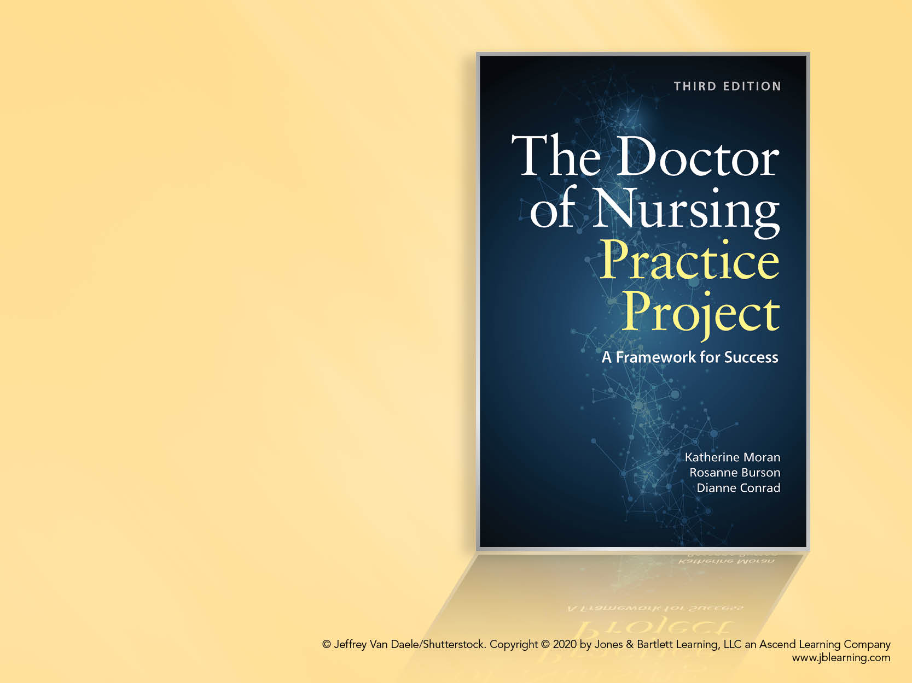
Chapter 5: The Phenomenon of Interest

Slide 2
Overview
Complex nature of nursing
Identification of the phenomenon
Significance of nursing phenomena
Selecting a phenomenon of interest for the DNP scholarly project

Slide 3
Objectives
Understand meaning of nursing phenomenon
Consider personal practice interests and expertise
Scan literature for potential areas of interest
Evaluate potential nursing theories
Explore the phenomenon through patterns of knowing
Apply the process of concept analysis to the phenomenon

Slide 4
Expertise of Nursing Practice
The practicing scholar is in the best position to:
Identify areas of clinical concern that require further research/improvement
Help address needs of patients within the community, organization, or healthcare unit

Slide 5
Expertise of Nursing Practice – cont’d
Nurse’s ability to understand the meaning of an event to the patient
Hidden work
Soft side
Nursing care is not measured
Might be what assists patients in meeting outcomes

Slide 6
Identifying Phenomenon of Interest
Nursing phenomenon defined
Identification derives from a practice situation that resonates
Cast a wide net
Reviewing published reports could help identify topics
Cumulative Index to Nursing and Allied Health Literature (CINAHL) database

Slide 7
Identifying Phenomenon of Interest – cont’d
Scanning the table of contents of professional journals or professional organization’s website may be helpful
Subject matter in area of practice or specialty
Identifying a clinical problem in context of the needs of the organization or population

Slide 8
Identifying Phenomenon of Interest – cont’d
Identify a broad category or area of interest
Drill down to a more specific focus
demonstrate a comprehensive understanding of the topic
Questions to ask:
Who, what, where, and when?

Slide 9
Examples of DNP Phenomenon Topics
Barriers to family presence during emergency department resuscitative efforts
Access and barriers to utilization of palliative care
Unreported blood and body fluid exposure

Slide 10
Examples of DNP Phenomenon Topics – cont’d
Disruptive behavior in the emergency department
Provider barriers to postpartum depression treatment
Cost effectiveness of crisis stabilization unit with a psychiatric unit

Slide 11
Identification of a Problem/Concern
Why is this topic important?
What is a concern?
Is there a need to change nursing practice to improve patient outcomes?
Is there an unmet societal need?
Does this concern occur frequently, warranting further exploration?
What does the literature reveal about this topic?

Slide 12
Using Nursing Theory to Explore a Phenomenon
Orderly way to view phenomena
Convey professional convictions
Systematic thinking about practice
Nursing theory
Concepts
Propositions

Slide 13
Using Nursing Theory to Explore a Phenomenon – cont’d
Construct
Level of abstractness
Grand theories
Important to knowledge development
Continue forming a base to specific practice theories

Slide 14
Phenomenon Through a Different Lens
Theoretical Framework
Identify the concepts
Look for published articles including the phenomenon
Identify concepts describing the phenomenon
Identify theories
Review theories online

Slide 15
Questions to Evaluate Theory
Does it reflect student’s personal practice?
Does it help to describe, explain, and predict the phenomenon?
Can it be a guide for the scholarly project?
Does it develop, assess, implement, and evaluate innovations that the project explores?
Will it help support excellent nursing practice?

Slide 16
Ways of Knowing
Patterns of knowing
Holistic framework to direct practice, education, and research
Carper’s 4 fundamental patterns of knowing
Empirical knowing
Esthetics
Personal knowledge
Ethical knowledge

Slide 17
Final Pattern of Knowing
Emancipatory knowing examines
social, cultural, and political status quo
vision changes that need to occur
Reflection and action
The phenomenon of interest may be framed by emancipatory knowing
The scholarly project is also a demonstration of praxis

Slide 18
Concept Analysis
Matches the phenomenon with concepts
Categorizes information and attributes
Distinguish between similar concepts, explain a term, or refine ambiguous concepts
Defining attributes of the concept is the primary work of concept analysis

Slide 19
Foundational Tenets and Options
Consider personal and professional philosophies
16 foundational tenets that are grounded in nursing theory

Slide 20
Keeping Your Options Open
Selecting a phenomenon of interest for the scholarly project is a fluid process
Ideas evolve and may develop into potential scholarly projects

