Slide 1
5 Things you should know about: Career Success for Nurse Practitioners
Kaitlynn M. Arvidson
Director, Graduate Career Placement
Kaitlynn.arvidson@regiscollege.edu

Slide 2
1- Understand the Purpose of the Resume, Curriculum Vitae (CV) and Cover Letter
Your Resume/CV- Your key to unlocking an interview. Based on factual information and evidence (qualitative and quantitative data) as support
Cover Letter- Summation of your academic and professional achievements drawing parallels to the role you’re applying combined with the value you will bring to the position/employer.

Slide 3
2- Have various versions of your Resume
Multiple versions if you’re applying for more than one type of NP role. Always use keywords aligning with the specific job description.
Many variations available; only 3 rules:
No typos
100% honest and accurate using facts
Ensure that it “tells a narrative” about your professional career based on facts that support your goals.
Notes:
The resume-- the first thing most people do because it’s concrete and it’s something everyone asks for. Our philosophy is that the resume should not be completed until you know what you want to do and why you are the best person for the job– you personal brand. You will most likely have more than one version of your resume and it should be tailored to the specific job you are looking for.
Writing a resume is an art, not a science. That is, there is no one way to write a resume. You can ask 10 people for feedback and you will get 10 different answers. The only 3 rules you need to know about resumes are: there can be NO typos. Proof it and ask others to proof it as well. Be 100% accurate and honest. Prospective employers do check every line and if it can’t be verified, you will not get the job. And, you need enough white space to make it easy to read. Employers review hundreds of resumes and if it’s not easy to read or they can’t see what they are looking for quickly, it will get moved to the bottom of the pile. Graduate Career Planning is always glad to assist you with this.

Slide 4
3- Include these sections in your resume
Name and contact information
Summary of Qualifications (if desired)
Education
Professional work experience
Certification/ Licensure/ Relevant Skills (EPIC, bilingual)
Community Involvement/ Professional Organizations
Awards
Research, Conference Presentations
Notes:
READ SLIDE. We will go through each section in further detail. First, your contact information.
Your education should include your college, only. Do not include high school.
Related experience: this is a chronological listing of your work experience, internships, unpaid work, no extra-curriculars in this section. You should list the organization’s name, a very brief description of the organization, city and state, your title and dates (month/year) of employment. For each experience listed, you should include 3 bullet points which clearly quantify your results. Be sure to use action verbs and refrain from using the word “we”.
Be sure to use lots of white space, keep it to two pages for a resume, CV can be longer, and do not go less than an 11 point font.

Slide 5
Determine if you need a Summary Statement
“Nursing professional with clinical experience in pediatrics seeking Pediatric Nurse Practitioner position in hospital setting. Known for stellar clinical assessment skills, ability to prioritize and collaborate on patient safety and quality of care.”
“Nursing professional with clinical experience in Emergency Department seeking Family Nurse Practitioner position in hospital setting. Clinical experience demonstrates track record of collecting and evaluating patient risks, outcomes, and care plans and coordinating direct care for the patient in collaboration with an interdisciplinary team.”

Slide 6
Community Involvement
List activities that support your career goals:
Professional Organizations: participation and leadership
Community Service: as it relates to the job, ie: American Red Cross
Selected achievements
Notes:
Other relevant activities: include here those extra curricular activities that support your career goals only. Here is where you can list the fact that you were Treasurer of a non-profit organization, a member of the Big Sister’s association, etc. You can also list anything in your background that helps you stand out– professional training, certification, community service.

Slide 7
4- Always Craft a Cover Letter
Purpose: Introduce yourself to a contact or an organization
Respond to a job
Connection between your resume and the opportunity
Why YOU are the right person

Slide 8
5- Important Cover Letter Content
1st paragraph: State why you are writing and identify the job you’re applying and organization name and why you’re interested
2nd paragraph: discuss your potential value and provide details surrounding your degree and professional experience
3rd paragraph: call to action and reiterate your interest in the organization

Slide 9
Questions??
Contact:
Kaitlynn M. Arvidson, Ed.M.
Director, Graduate and Professional Career
Planning
Click to schedule a career coaching appointment:

Slide 10
The NP Interview and Salary Negotiation: 5 Things you should know
Kaitlynn M. Arvidson
Director, Graduate Career Placement
Kaitlynn.arvidson@regiscollege.edu

Slide 11
1- Develop Your “1-min Commercial”
“Tell me about yourself” Your background- academic and career information
Why are you interested in this position?
Bring your professional portfolio to the interview and offer to show the employer or send electronically later

Slide 12
2- Practice Behavioral Interviewing
If you could change one rule in the ER, what would it be and why?
How would you respond to these three patients: the first patient feels a gush of blood, the second has ruptured and is in early labor, and the third has a question about prescriptions before going home.
How do you see your role as NP enacted differently from what you were doing as an RN?
Give an example/s of how a NP’s communication with patients differs from that of a physician?
How do you keep current on medical findings and practices?

Slide 13
3- Master the STAR Method
Situation
Tasks
Action
Result
Notes:
Describe the Situation that occurred, the Tasks at hand, the Action you took to correct the problem or challenge and the Result of the action. The result can be positive (describe the impact the result had on the situation, patient, clinical team and/or organization) or negative, leading you to adjust your plan for a future situation gaining areas for growth and opportunity. A positive or negative result is perfectly acceptable to share with an employer, so long as you can discuss areas of opportunity and learning outcomes from a negative result.

Slide 14
4- Prepare Questions for the Interviewer
Prepare 4-6 questions, plan of asking 2-3
What are the attributes that make NPs successful at your organization?
How will the candidate selected for this role be evaluated?
Do you have an orientation program for new NPs?
Do you offer back-up support when needed?

Slide 15
Closing
Thank the person for their time
Reiterate your interest
“If there are 3 things I’d like you to remember me by…”
Ask: What is the timeline for the selection process?

Slide 16
5- Write Thank You Notes!
Ensure that you send a thank-you note via email to each person you met with for the interview
In each email, reiterate your interest in the role (cite 2 reasons based on facts you learned at the interview) and state 2-3 reasons why you are a good fit for the position. Close the note letting the interviewer know if they require any additional information, they are free to can contact you

Slide 17
Salary Negotiation for NPs Resources
Salary Negotiation tips: https://www.myamericannurse.com/tips-salary-negotiations
US Bureau of Labor: https://www.bls.gov/
https://comphealth.com/resources/negotiate-higher-pa-np-salary/
https://www.aanp.org/practice/practice-management/employment-negotiations
https://www.melnic.com/negotiate-your-new-nurse-practitioner-starting-salary/

Slide 18
5 Things you should know about salary negotiation:
1- Know that negotiation is normal
2- Do your research
3- Consider your leverage
4- Play the negotiation game
5- Believe in yourself enough to sell yourself!
https://www.myamericannurse.com/tips-salary-negotiations/

Slide 19
Salary Negotiation Tips
Let employer know you’re interested
Don’t give an immediate answer to salary offer
Know the market value of the role, asking for more that market value will backfire. Your counteroffer should be within the upper range of what you discovered through your research
Speak to the value/contributions you will make
Obtain written job offer

Slide 20
Linked-in Strategies NPs can Employ Today!
Kaitlynn M. Arvidson
Director, Graduate Career Planning Kaitlynn.arvidson@regiscollege.edu

Slide 21
Why do Nurses need Linked-in?
What are 3 ways Linked-in can benefit your nursing career?
Great resource for developing your profile, even speaks to leadership roles, perfect for the CNL:
https://careers.eisenhowerhealth.org/personal-and-professional-wellness/8-linkedin-profile-hacks

Slide 22
Elevate your nursing career with
Showcase your career and academic experience
Develop a professional social media presence associated with your career path as an NP
Discover career opportunities
Connect with other NPs and forge new relationships
Join professional nursing organizations allowing you to become active in the field starting today

Slide 23
Top 5 things every nurse should have on their Linked-in profile in addition to the “typical” resume info:
Profile Photo
Summary
Volunteer Experiences & Causes
Skills & Expertise
Courses/Projects

Slide 24
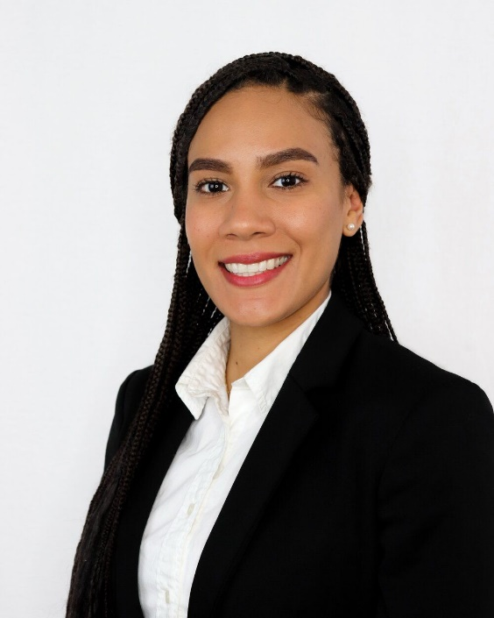
Photo
No Selfies- camera should be directly in-front of you to allow for Linked-in cropping
Professional- Make a good impression, communicate who you are and what you’re about.
Posture- defines confidence
Notes:
Next, your objective or summary of qualifications. This is a 1-2 sentence statement that details what you are looking for and why you are qualified for the job, what makes you unique-- this is taken right from your mind dump. We recognize that some colleges recommend that you do not include your objective or any kind of summary. Again, this is an art not a science so you have to work with what you are comfortable with. READ EXAMPLES
You can list your summary as an objective, a summary of qualifications or a listing of your key skills.

Slide 25
Is this picture bad?

Slide 27
Summary
Lead with a narrative:
Your goal
Specialty areas
Level of experience
Your personal brand
Examples of personal brand:
Critical thinking
Problem solving
Attention to detail
Calm under pressure
Collaboration
Notes:
Next, your objective or summary of qualifications. This is a 1-2 sentence statement that details what you are looking for and why you are qualified for the job, what makes you unique-- this is taken right from your mind dump. We recognize that some colleges recommend that you do not include your objective or any kind of summary. Again, this is an art not a science so you have to work with what you are comfortable with. READ EXAMPLES
You can list your summary as an objective, a summary of qualifications or a listing of your key skills.

Slide 28
Volunteer Experiences & Causes
List activities that support your career goals:
Professional Organizations: participation and leadership
Community Service: as it relates to the job, ie: American Red Cross, FEMA
Selected achievements
Notes:
Other relevant activities: include here those extra curricular activities that support your career goals only. Here is where you can list the fact that you were Treasurer of a non-profit organization, a member of the Big Sister’s association, etc. You can also list anything in your background that helps you stand out– professional training, certification, community service.

Slide 29
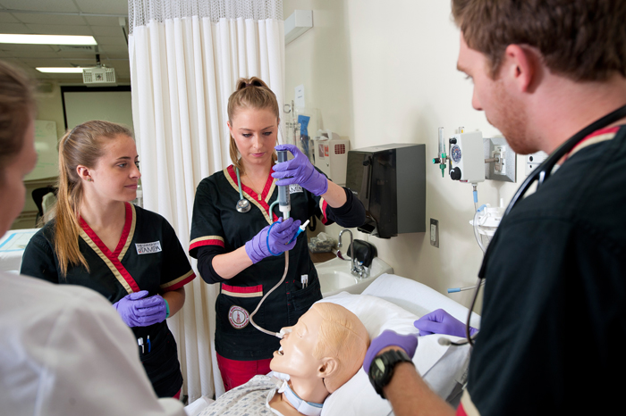
Skills & Expertise
List clinical and professional skills gained in your work experience or clinicals/leadership mentoring:
BLS/CPR
Advanced Cardiac Life Support
Cultural Competency
Critical Care Nursing
Acute Care
Medical-Surgical
Electronic Medical Records
Patient Advocacy
Nursing Education
Clinical Research

Slide 30
Courses & Projects
List a few courses aligning with the NP role:
Health Policy, Politics and Perspectives
Advanced research/evidence-based practice
Nursing leadership
Advanced pathophysiology
List Conference, poster presentations and discuss your research by providing a link to your work.
Notes:
Other relevant activities: include here those extra curricular activities that support your career goals only. Here is where you can list the fact that you were Treasurer of a non-profit organization, a member of the Big Sister’s association, etc. You can also list anything in your background that helps you stand out– professional training, certification, community service.

Slide 31
Professional Associations and Linked-in Groups for Nurses
American Association of Nurse Practitioners
Gerontological Advanced Practice Nurses Association
Nurse Practitioners in Women’s Health
National Association of Pediatric Nurse Practitioners
Oncology Nursing Society
Emergency Nurses Association
Notes:
Other relevant activities: include here those extra curricular activities that support your career goals only. Here is where you can list the fact that you were Treasurer of a non-profit organization, a member of the Big Sister’s association, etc. You can also list anything in your background that helps you stand out– professional training, certification, community service.

Slide 32
Professional Etiquette
1- Always introduce yourself, you won’t feel awkward in situations if you take the initiative to do this right away
2- Introduce colleagues: Sharon, I'd like to introduce Jack Brown. Jack is our new staff nurse with two years' experience in the PACU. Jack, Sharon Jones has been our vice president of nursing since 2017.“

Slide 33
Zoom and on-site meetings
Be aware of what image your body language is sending. Here are some body language tips to follow:
* Stand tall, shoulders back, chin up
* Keep your hands out of your pockets.
* Don't put your hands on your hips or cross over your
chest.
* Use a sincere smile to denote warmth and
friendliness.
* Look at the eyes of the person you're talking with to show
your interest.
* Don't wring your hands or make a fist.

Slide 34
ZOOM and remote meetings
Dress professionally even though you’re not at work physically
Act as though you are at work, no eating, drinking (bottle of water is fine), becoming sidetracked by others at your home, no multi-tasking
Work in a clean, organized professional space that is camera-ready- plain background
Eliminate all distractions (do not fidget) so you are focused on the screen the entire time, reacting to the meeting and participating fully
https://www.wsj.com/articles/seven-rules-of-zoom-meeting-etiquette-from-the-pros-11594551601

Slide 35
Zoom Etiquette

