Slide 1

CASE Formulation
Michelle Gibson, PMHNP-BC, CARN-AP

Slide 2



Introduction
AKA a biopsychosocial formulation
Case formulation is not a restatement of facts
It’s a written attempt at understanding a patient
Provides written record for communication with others
Becomes the foundation upon which treatment is based
Many ways to write formulation

Slide 3


The anatomy of case formulation
Three basic components
  Descriptive
    “What happened?”
  Etiological
    “Why did it happen?”
  Treatment-prognostic
    “What can be done about it and how?”
Notes:
Descriptive answers the What happened? Etiological formulation answers Why did it happen. Treatment an explicit blueprint governing treatment interventions & prognosis. It answers the What can be done about it and how.

Slide 4

Formulation approach
Step 1
Write a summary paragraph
Step 2
Identify obvious etiological data
Step 3
Use the formulation matrix to structure the date and prompt identification of other data/theories
Step 4
Connect data to the present via the theory
Step 5
Write out the formulation reading the matrix horizontally
Notes:
1.Brief description contextualizing the patient and their issues. 2. Use data from past and present to develop a hypothesis about the patients current presentation. 3.Use the formulation matrix to structure the obvious data, putting them into the appropriate matrix box. Start vertically. 4. Describe how this data explains the present circumstances for the patient. Not every piece of data in the table needs to be used. It’s for brain storming. 5. Makes more narrative sense to move from the past to present to the future

Slide 5
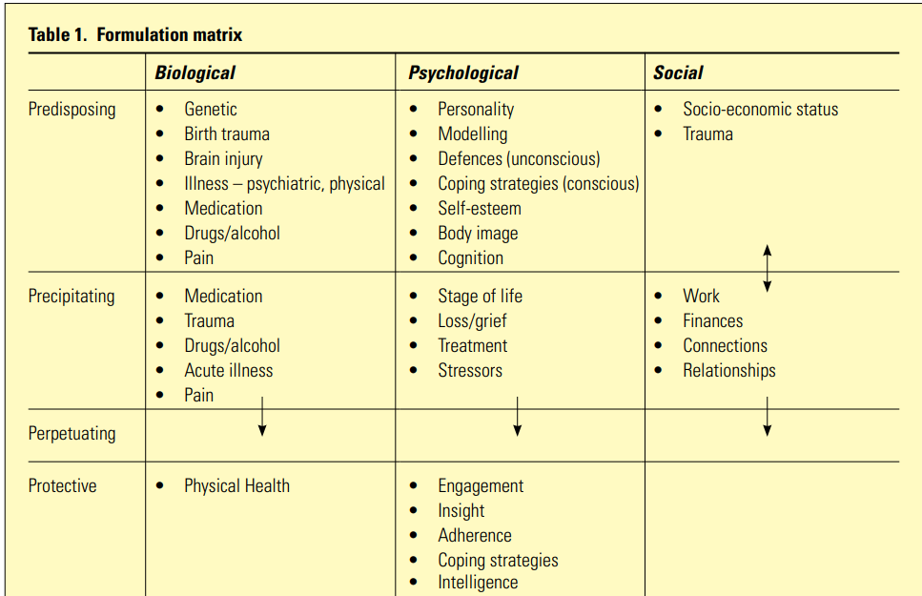

Slide 6

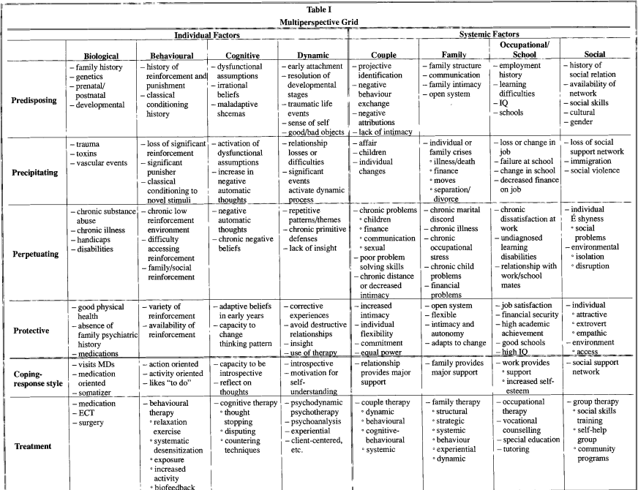

Slide 7
The Case of Mr. Z.
Mr. Z is a 40-year-old businessman who presented with complaints of loss of interest in his job, hobbies, and family over a period of six weeks. He acknowledged periods of profound sadness, reduced appetite with significant weight loss, insomnia, fatigue, and recurrent thoughts of death, but denied suicidal ideation. He denied any precipitants but did admit that his expected job promotion had not materialized. Mr. Z described himself as unusually serious, conservative, and relatively unable to express affection. He also acknowledged trying to be perfect, needing to be in control of every social situation, and having an excessive commitment to work. Mr. Z indicated his marriage had been worsening for several years and described his wife as flighty, overemotional, and helpless under stress. For the past several years she had been angry, distant, and had declined to be involved sexually with him. Since the onset of his symptomatology, however, she had been obviously concerned. The Z's have two children, a boy, 12, and a girl, 10, who appeared to be doing well at school and home. Mr. Z described his family of origin as very poor. His father deserted his mother when the patient was 12 years of age and, as the oldest child, he had to take considerable responsibility for younger siblings as well as to work part time while attending school. He knew that his maternal grandfather had died by suicide and that two maternal uncles had alcohol use disorder. A paternal uncle had died in prison after a long period of antisocial behavior.

Slide 8
Descriptive
Mr. Z is a 40-year-old married businessman whose depressive-like symptoms began shortly after being passed over for a promotion. Other stressors appear to be chronic marital and sexual problems and the fact that his two children are nearing the age of independence and the age when he experienced a significant trauma in his own life, i.e., the desertion by his father when he was 12. Although there is a positive family history for alcoholism, suicide, and sociopathy, Mr. Z denies other psychiatric symptoms or treatment for himself. Mr. Z’s family history of alcoholism, suicide, and sociopathy makes it likely that he has a genetic predisposition for affective illness. He appears to have major conflicts over dependency and autonomy. Because of his earlier experience with significant loss, the withdrawal of attention and affection by Mr. Z’s wife and the growing independence of his children represent significant precipitating events. Mr. Z has considerable difficulty expressing emotions and affection. He is controlling and perfectionistic. His cognitive style is obsessive-compulsive. His primary defenses are repression, regression, introjection, isolation of affect, and intellectualization. Mr. Z's sociocultural background has helped to instill in him a basic belief in the value of hard work, stoicism, and self-reliance with little dependence on extra-familial sources of support. From a young age, he has been reinforced to sacrifice himself and to maintain the role of provider and nurturer to others who have depended upon him for support. Mr. Z is also distant from his family of origin and his current life centers around his immediate family. His role has been as a provider to a wife and children who have been dependent upon him. Mr. Z and his wife have not been able to form a satisfactory marital coalition, they do few things together, and their sexual relationship has deteriorated. His wife had withdrawn emotionally and sexually from him until his recent problems, which promoted her attention and concern. Mr. Z has been able to adapt fairly well educationally and occupationally and is a successful businessman. However, he has limited social relationships, no close friends, and few independent recreational activities.

Slide 9
Etiological
Mr. Z’s probable biological predisposition to affective instability, coupled with the abandonment by his father and familial and sociocultural reinforcement, resulted in the development of a rigid, obsessive-compulsive personality. His role evolved into one of stoic, hard-working, self-sacrifice in the service of others who are dependent upon him, and a denial of his own dependency needs. While adaptive educationally and occupationally, his personality structure and ego defenses resulted in an isolated lifestyle and the inability to acknowledge his own feelings or to relate to others with warmth and affection. The symbolic abandonment by his wife and children reawakened old dependency conflicts, threatened his adaptive role in life, overwhelmed his rigid defenses, and resulted in anxiety, regression, and depression.

Slide 10
Treatment-prognostic
A problem list includes clinical depression; marital discord including sexual difficulties; an obsessive-compulsive style; limited social support system with friends; and limited recreational activities. Initial treatment will include an antidepressant and supportive psychotherapy evolving to insight-oriented treatment as depressive symptoms abate, possibly in a group format. Couples therapy including work on sex issues could also be initiated after symptom amelioration. Finally, the patient will be aided in increasing his support system and recreational activities. Since this is a single, discrete episode of depression in a person with good pre-morbid functioning, the prognosis for a return to a baseline level is good. It is likely that Mr. Z’s depressive symptoms will respond to medication. His obsessive-compulsive personality disorder and unmet dependency needs are long-standing problems with a more guarded prognosis that depends on his ability to engage in effective psychotherapy and to expand and modify his range of contacts and activities. The prognosis for his marriage is also guarded and depends upon both his willingness and his wife's willingness to examine their relationship, explore new avenues of interaction, and modify their roles. Marital therapy will likely be required to accomplish these goals.

Slide 11

Thank You!

