Slide 1
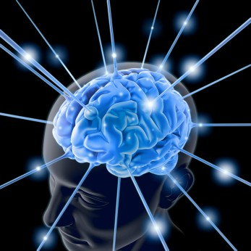
Neuroanatomy & Neurophysiology
NU664C

Slide 2
Nervous System
Essential knowledge required
Agenda
  Organization of NS
  Brain anatomy
  Neurophysiology
  Neuron
201312/12
2

Slide 3
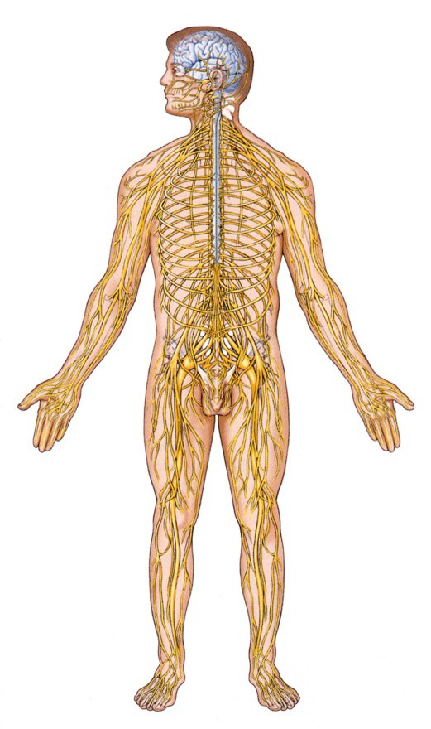
Nervous System
CNS
  (Central Nervous System)
    Brain
    Spinal Cord
PNS
  (Peripheral Nervous System)
    Peripheral Nerves
    Ganglion

Slide 4
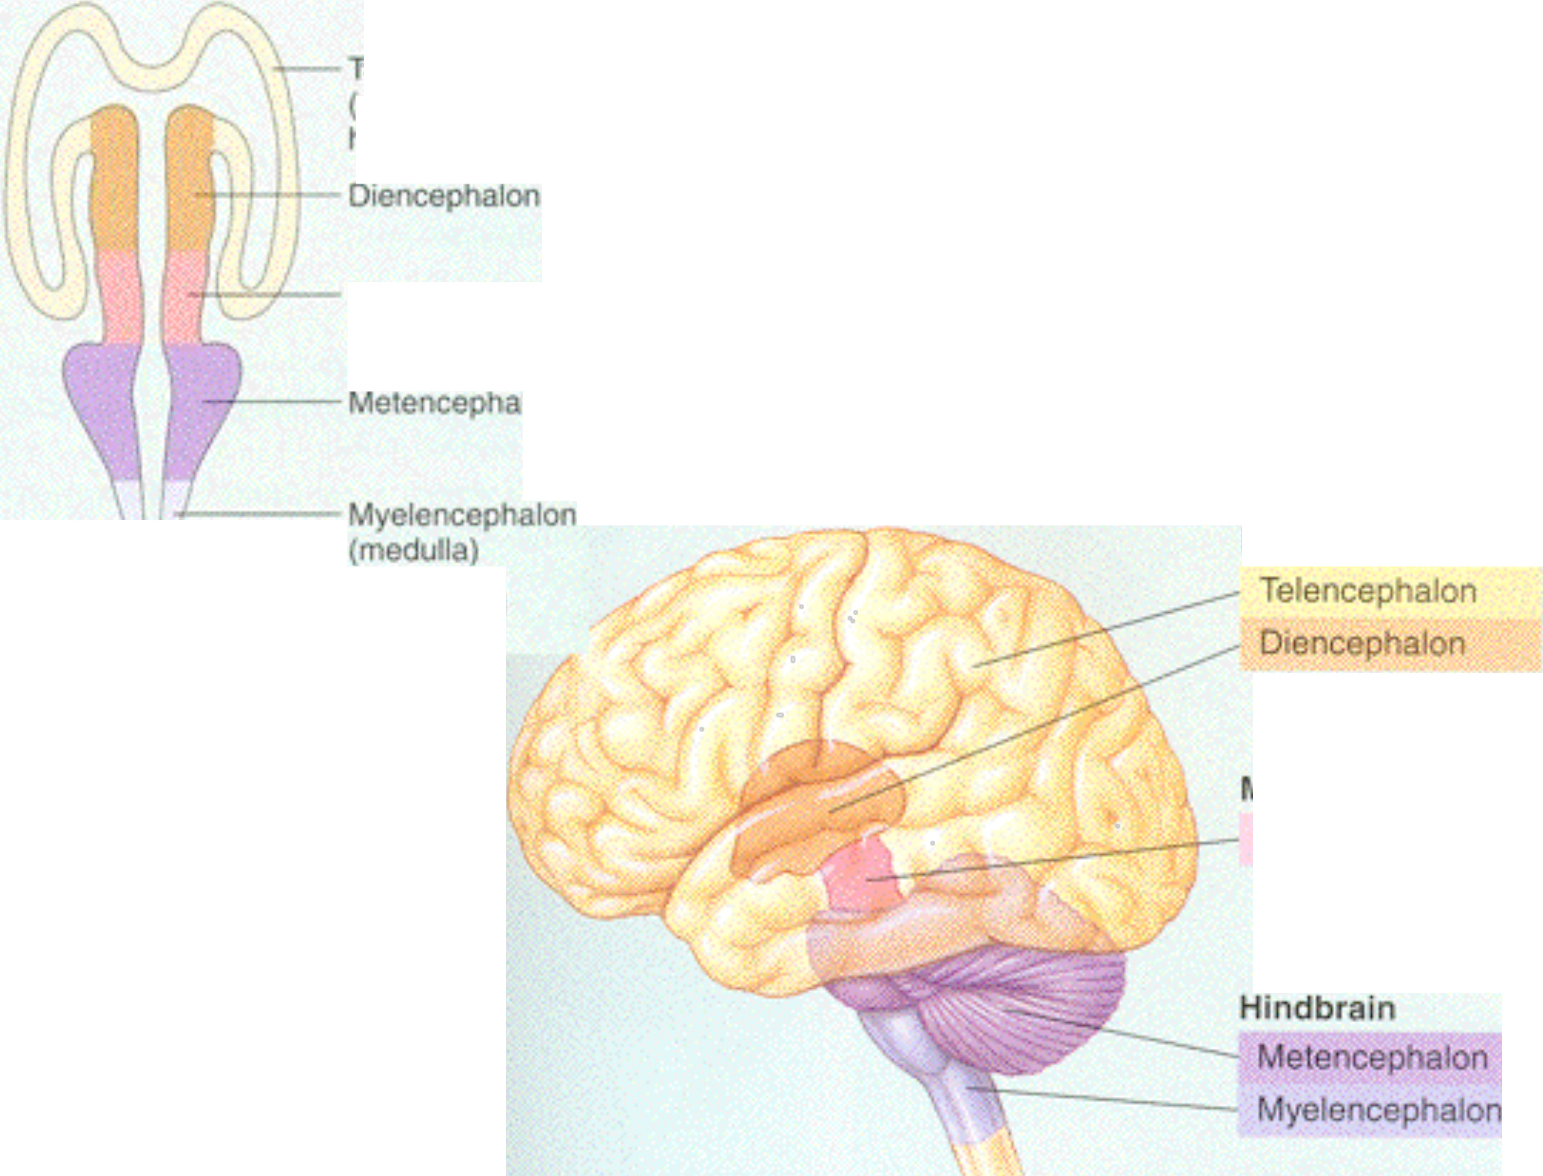
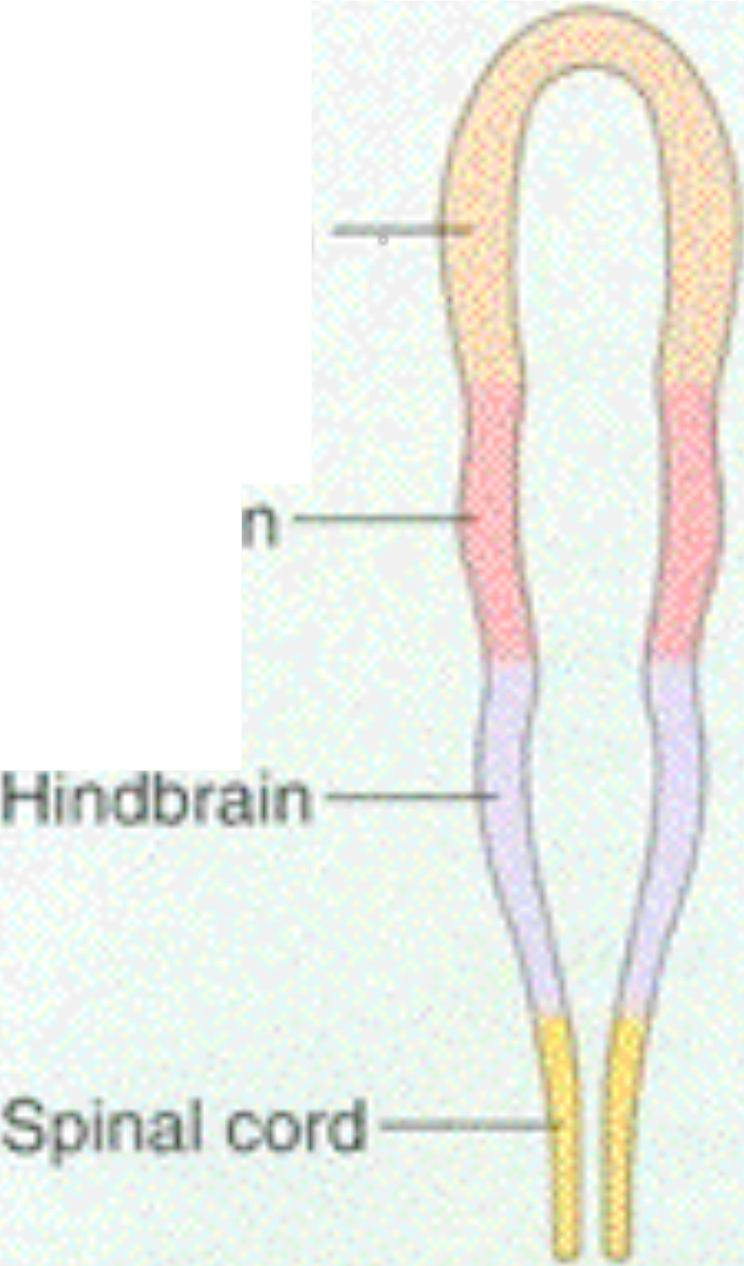
ajar subdivis·ons oft e nervo s syst m
ele cep lo
ce obral
h s res)
Forobrain
1dbrai
......i-.¥.J.-
Mcscncep aon
( id ran)
10
Forebrain
- --Spinal cord
idbraln
ese cep a on

Slide 5
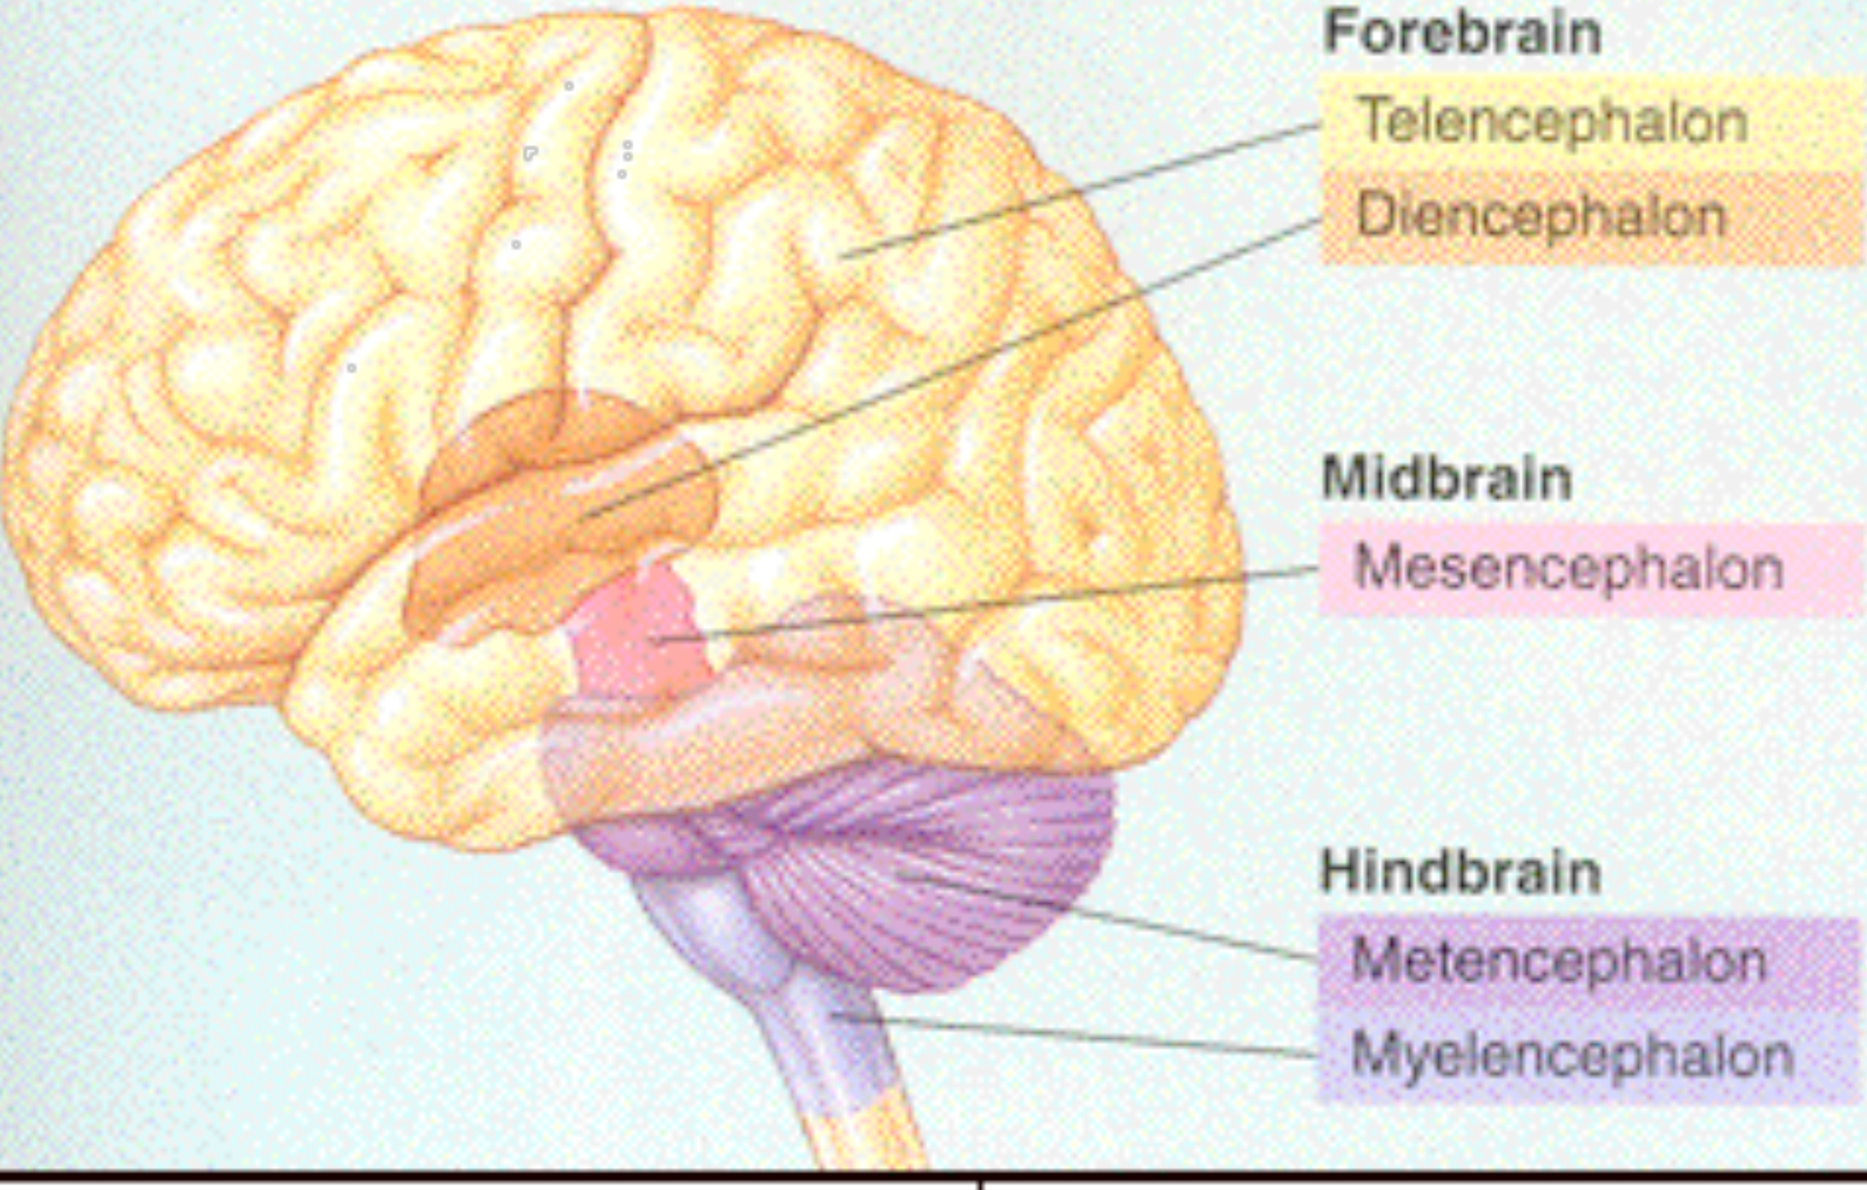
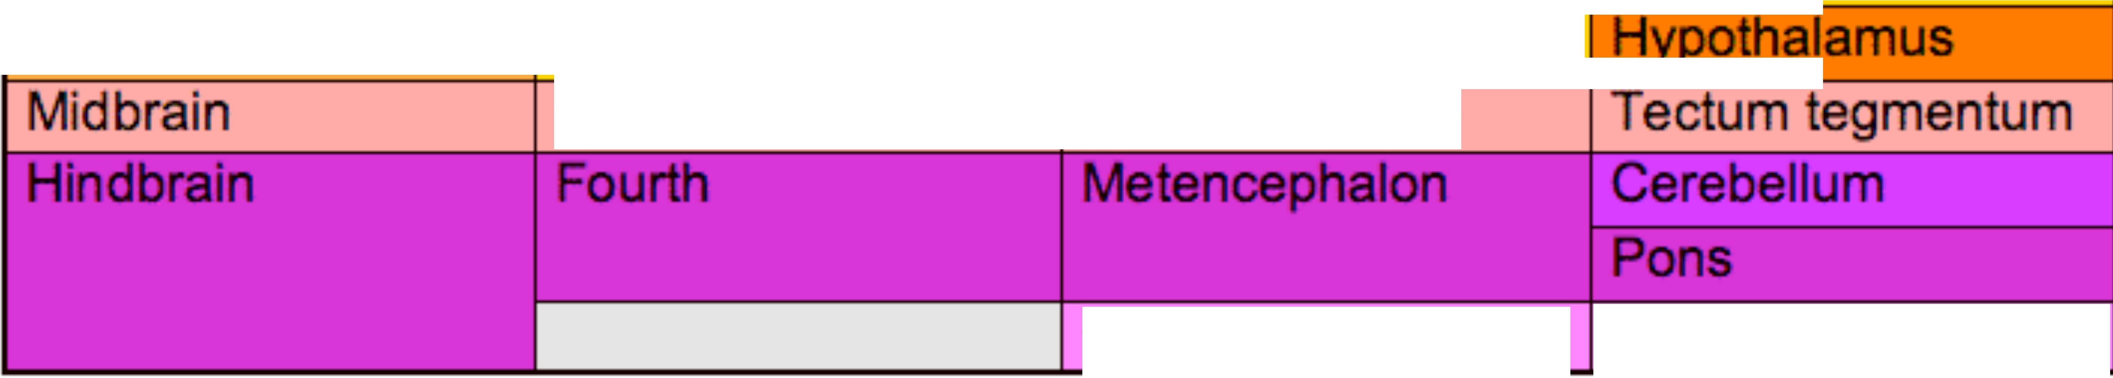
ajar s bdivisions of t e n rvous system
Major division | Ventricle | Subdivision | Principle Structures
Forebrain | Lateral | Telencephalon | Cerebral cortex
 |  |  | Basal ganglia
 |  |  | Limbic system
 | Third | Diencephalon | Thalamus
 |  |  | I
 | Cerebral aqueduct | Mesencephalon
Myelencephalon
Medulla oblongata

Slide 6
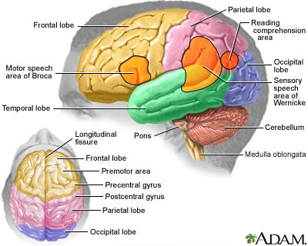
Developed Brain
Grey and White matter
Right Hemisphere
  Artistic
  Visual-spatial
  Musical
  social cue perception
Left Hemisphere
  Logic
  Rational thinking
  Sequencing
6

Slide 7
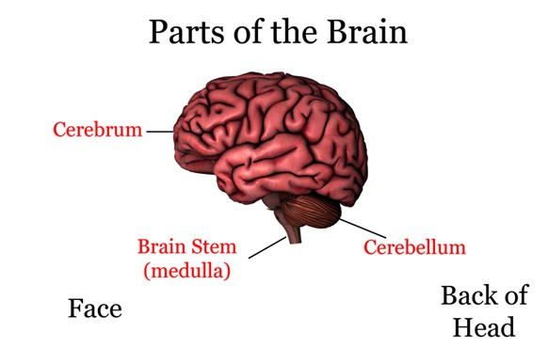
Major Parts of the Brain
Cerebrum
Cerebellum
Diencephalon & Basal Ganglia
Brainstem
Spinal Cord
7

Slide 8
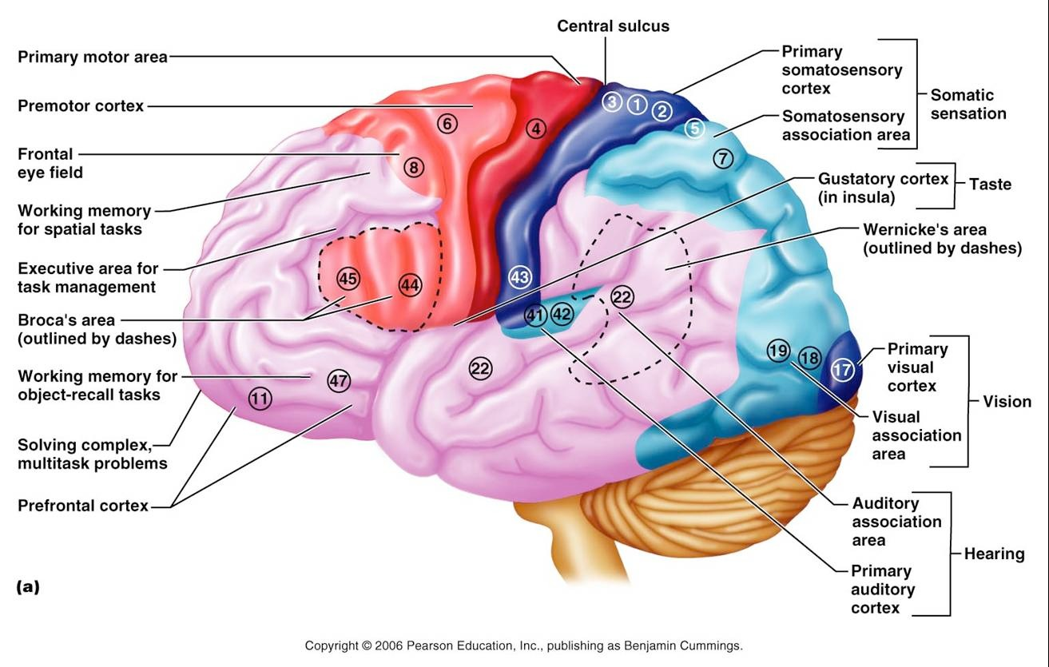
Cerebrum

Slide 9
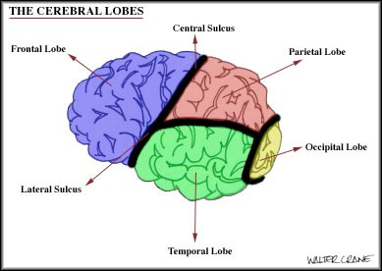
Cerebrum

Slide 10
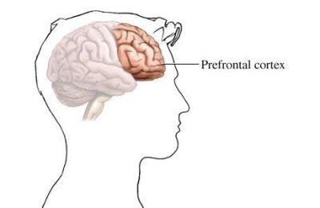
Frontal Lobe
Prefrontal Area-most frontal region
Responsible for highest intellectual functioning
  Judgment
  Reasoning
  Conceptual Planning
  Abstract Thinking
10

Slide 11
Frontal Lobe
Function
  Executive functioning and personality
Damage effect
  L: depression, apathy, ê speech, apathy
  R: impulsivity, confabulation, verbosity
  Medial: difficulty speaking, motor abnormalities
  Orbital: emotional unresponsiveness, dysinhibition
Psychopathology
  Frontal lobe syndrome
  Schizophrenia
  Depression
  Anxiety

Slide 12
Frontal Lobes: LIMP
L: language
I: intellect
M: motor function
P: personality

Slide 13
Disruption of Cortical Functions
Aphasia: disruption of language function
Apraxia: disturbance in the organization of voluntary action
Agnosia: disorganization of perception and recognition; naming problems
Amnesia: dysfunction of memory processes
Dementia: deterioration in intellectual and cognitive functions

Slide 14
Frontal Lobe Syndrome
Personality changes exhibited
Emotional changes exhibited
Intellectual changes exhibited

Slide 15
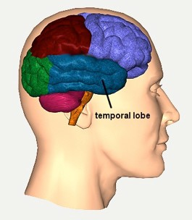
Temporal Lobe
Language
Memory
Emotion
  Ties in with the limbic system
Receives
  Olfactory impulses
  Auditory impulses
  Memory
15

Slide 16
Temporal Lobe
Function
  Emotion and memory circuits
Damage Effect
  Fear, anxiety, anger and paranoia
  Hyper-religiosity
Psychopathology
  Auditory hallucinations and delusions assoc. w/dep, mania and schizophrenia

Slide 17
Temporal lobes: LAME
L: Language (receptive): Wernicke’s area
A: Affective component of speech
M: memory
E: emotion

Slide 18
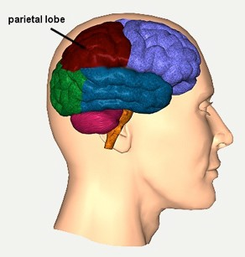
Parietal Lobe
Visual, tactile, & auditory input
Left side
  verbal processing
Right lobe
  visual-spatial processing
18

Slide 19
Parietal Lobe
ÜFunction
ÜBody sensations
ÜDamage Effect
ÜImpairment of attention, conc, language, number sense, grammar
ÜVisual-spatial relations; ability to learn from past experiences
ÜPsychopathology
ÜAphasia, agnosia, apraxia
ÜOut of body experiences

Slide 20
Parietal lobes: VAST
V: visual spatial processing
A: association cortex (visual, auditory, taste, smell, kenetics)
S: symbolic recognition
T: topographic sense

Slide 21
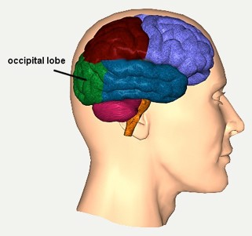
Occipital Lobe
Primary lobe for visual input
Receives & interprets visual input
Forms visual associations
21

Slide 22
Occipital lobe
ÜFunction
ÜVision
ÜDamage Effect
ÜVisual loss
ÜHallucination e.g. sparks, tongues of flames, flashes of light
ÜDifficulty understanding meaning of written word
ÜPsychopathology
ÜBlindness, color blindness, impaired depth perception and visual orientation

Slide 23
Occipital lobes: VIP
V: Visual
I: integration area
P: primary visual cortex

Slide 24
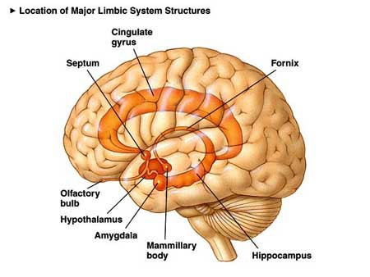
Limbic System

Slide 25
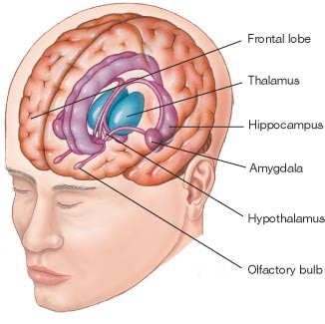
Limbic System
Olfactory nerves, bulbs, & tracts
“nose brain”
Amygdala
Hippocampus
Nucleus accumbens
Hypothalamus
Thalamus
25

Slide 26
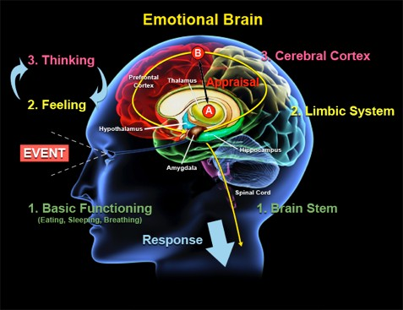
Functions of the Limbic System
Emotional Memory
Aggression
Emotion
Motivation-basic drives
Appetite/eating
Sex drive/activity
Integration of smell
26

Slide 27
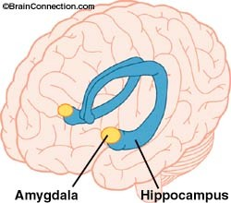
Amygdala
Critically important gate through which internal and external stimuli are integrated
Damage to the amygdala has been reported to destroy the ability to distinguish fear and anger in other person’s voices and facial expressions.

Slide 28
Amygdala
Function
  Anxiety and anger; generates rudimentary emotions—rage, religious ecstasy, sexual desire
  Contributes to establishing emotional memories
Damage Effect
  Tumors assoc w/irritabiity, anger, rage and aggression
Psychopathology
  PTSD, phobias, panic, depression, schiz, autism

Slide 29
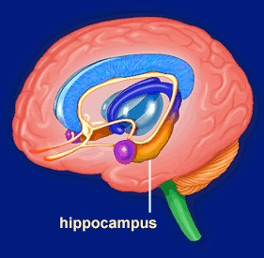
Hippocampus
Important for making new memories—may be implicated in Alzheimer's Disease
May be involved in depression and bipolar—appears to shrink

Slide 30
Hippocampus
ÜFunction
ÜLearning, memory, retrieval of information
ÜBuilds cognitive maps; assigns time and place for the event
ÜDamage Effect
ÜImpaired ability to pay attention, learn new things, and remember or alter pre-existing learning
ÜPsychopathology
ÜPTSD
Üê volume in those w/depression, low self-esteem

Slide 31
Nucleus Accumbens
Function
  Modulates limbic system
  Involved in reward and pleasure
Damage Effect
  Damage following repeated meth use
  Flat affect, social isolation and loss of interest
Psychopathology
  Substance abuse and addiction

Slide 32
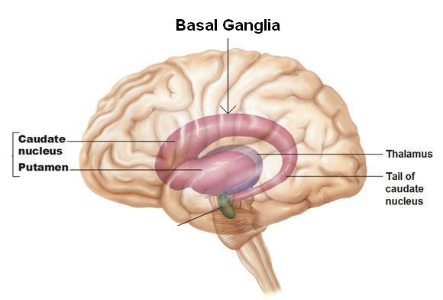
Basal Ganglia
Subcortical group of gray matter nuclei
Control system for muscle movements & cognitive functions
Mediates postural tone
Part of the Extrapyramidal System
32

Slide 33
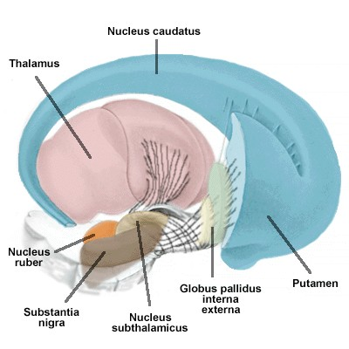
Basal Ganglia
Group of nuclei- functionally related
Primarily involved in motor control
Caudate nucleau, Globus Pallidus, Putamen

Slide 34
Basal Ganglia
Ü Function
ÜBrings together emotion, exec func, motivation and motor activity
ÜInvolved in posture, motivation and motor activity
ÜControls extrapyramidal motor tract
ÜDamage Effect
ÜSlowness of movement, rigidity, cogwheel rigidity and dystonias
Ü Psychopathology
ÜOCD
ÜCognitive and emotional dysfunction
ÜExtrapyramidal tract symptoms

Slide 35
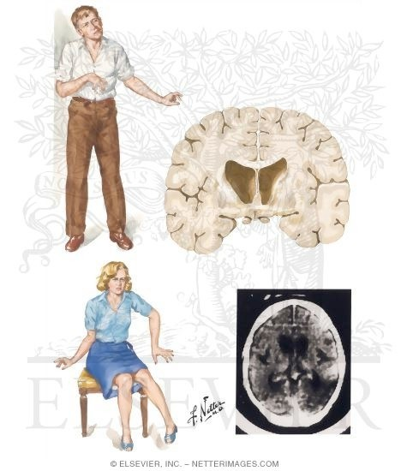
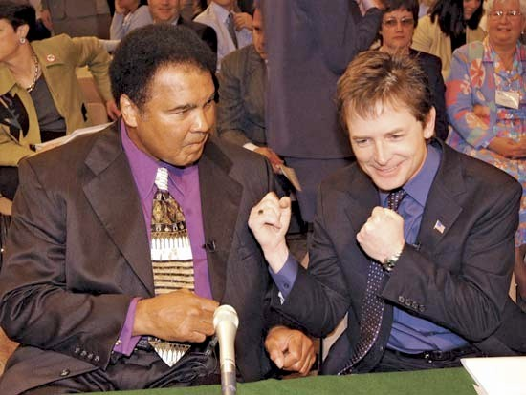
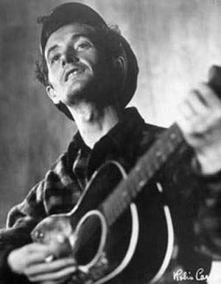
Damage to basal ganglia
Parkinson’s disease Huntington’s chorea, Tourette’s

Slide 36
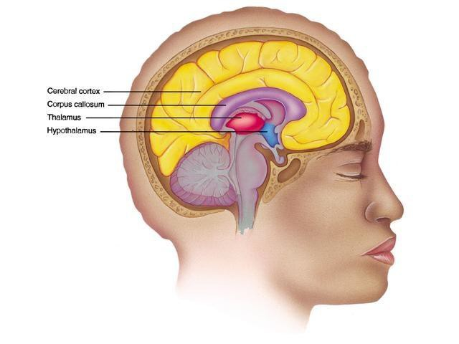
Diencephalon (Forebrain)
Thalamus
  Integration or relay system of brain
  Sensory role
Hypothalamus
  Hormones synthesized & released
  Goes to pituitary
36

Slide 37
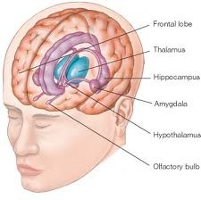
Thalamus
Large mass of gray matter situated in forebrain
Sensory and relay center
Axons from every sensory system synapse here

Slide 38
Thalamus
Function
  Processes information
  Wakefulness, sleep and pain perception
Damage Effect
  Over-flooding of information (or
  Apathy, drowsiness and disturbed perception
Psychopathology
  Negative symptoms of schiz

Slide 39
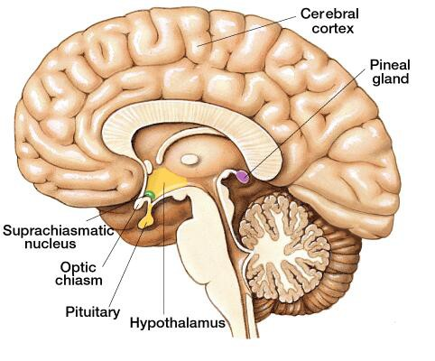
Hypothalamus
Regulates:
  Sex hormones
  Blood Pressure
  Body temp
  Sleep
  Appetite
39

Slide 40
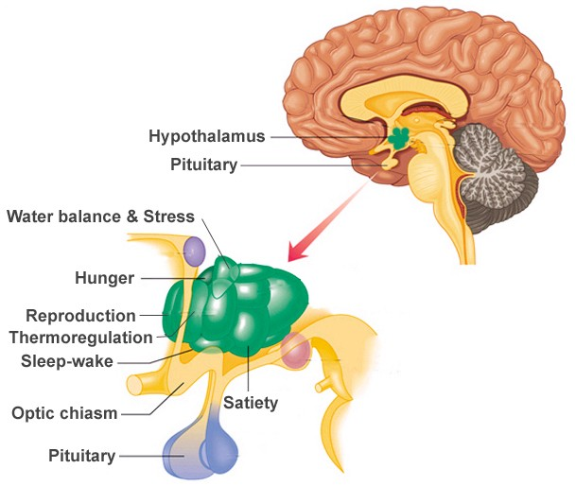
Hypothalamus
Group of nuclei Involved in many functions
  Autonomic control
  Temperature regulation
  Thirst and appetite
  Endocrine control
  Emotional reactions
  Sleep and wakefulness
  Stress response

Slide 41
Hypothalamus
Function
  Bridges internal homeostasis and outside environment
  Assoc w/ raw emotions of pleasure, reward, aversion and rage
  Involved in hunger, thirst, water balance, regulation of temp, circadian rhythms and stress response
Damage Effect
  é eating, emotional instability, rage
  Changes in temp, sleep and sex func
  Uncontrolled laughter and crying
Psychopathology
  Aggression, violence, anorexia, depression altered sleep-wake cycle

Slide 42
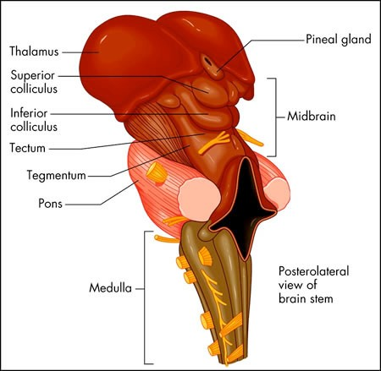
Brainstem
(midbrain, medulla oblongata, pons,)
Function
  MO: regulates BP, R, digestion; reflex center
  P: relays info from cerebral hemispheres to cerebellum
  M: eye movements; other sensory function
Damage Effect
  P: dysinhibition, anxiety, dep, personality changes
  M: tics
Psychopathology
  PTSD
  Psychosis, coma, death

Slide 43
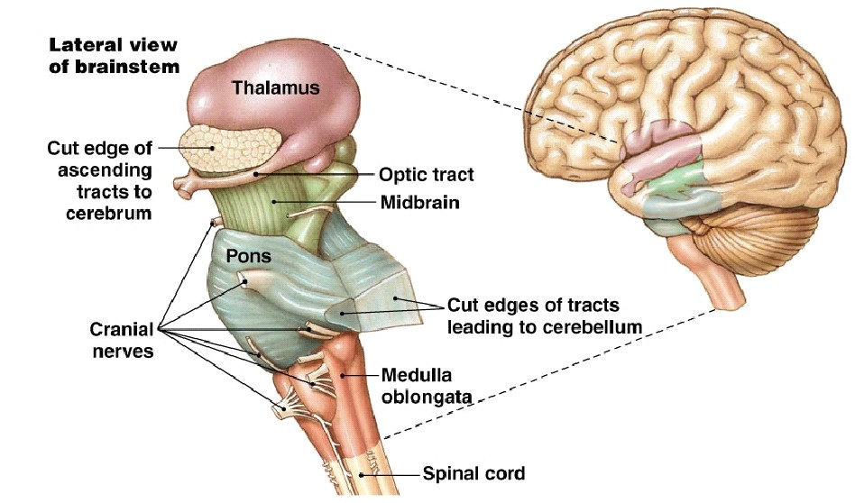
Brainstem:
Midbrain and Hindbrain
Includes midbrain (reticular formation, substantia nigra) and hindbrain (pons, medulla,and cerebellum)
Made up of cells that produce neurotransmitters

Slide 44
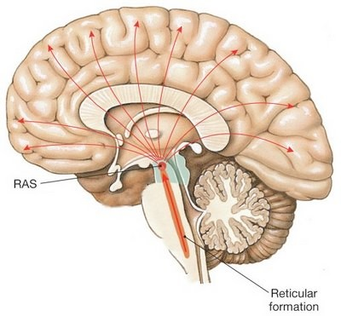
Reticular Information System
“Primitive brain”
Receives input from cortex; integration area for input
Functions include:
  Involuntary movement
  Reflex
  Muscle tone
  Vital sign control
Critical to cs and ability to focus mentally, to be alert and pay attention

Slide 45
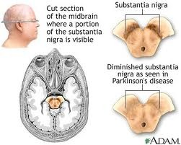
Substantia Nigra
Thought to be implicated in the development of Parkinson’s disease
Area of cells that release essential neurotransmitters
Important for movement and coordination

Slide 46
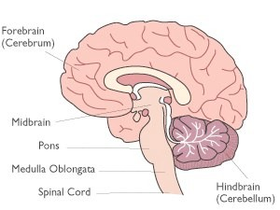
Medulla Oblongata
Portion of hindbrain
Controls autonomic functions; respiration, digestion, heart and vessel function
Important for transfer of messages since motor and sensory neurons travel through this area

Slide 47
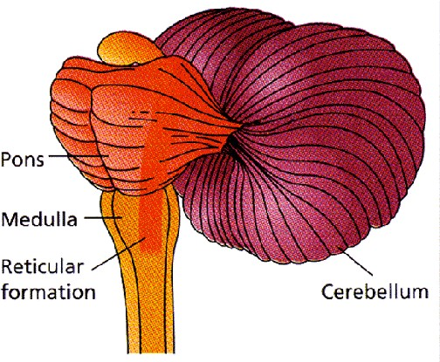
Pons
Pons—latin for bridge
Connects cortex with medulla
Houses the locus ceruleus-area for NE production
Serves as communication center between the two hemispheres

Slide 48
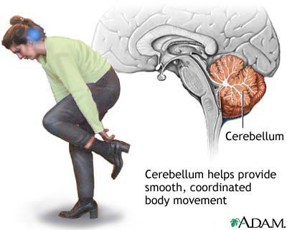
Cerebellum
Involved in the control of movements and postural adjustments
Equilibrium
Planning of movements prior to initiation
48

Slide 49
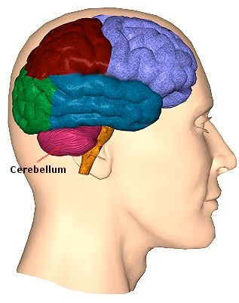
Cerebellum
Coordination of voluntary motor
movement, muscle tone, balance and equilibrium
Balance—Rhomberg test
Damage leads to
– Ataxia, intention tremors, weak muscles nystagmus, dysarthria, tendency toward falling

Slide 50
Cerebellum
ÜFunction
ÜAuxiliary structure for the entire cerebral cortex
ÜPosture and balance
ÜDamage Effect
ÜImpairment in balance, standing, gait
ÜAtaxia, tremors and nystagmus
ÜPsychopathology
ÜThought to be involved in autism
ÜIn children: clumsiness, delayed milestone, language problems, inability to read social cues

Slide 51
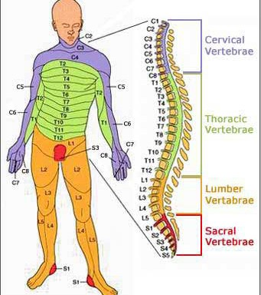
Spinal Cord
Made of Pyramidal Tracts
– pathways that extend from the cortex to the spinal cord & then to motor nerves
Regulates the activity of skeletal muscles
51

Slide 52
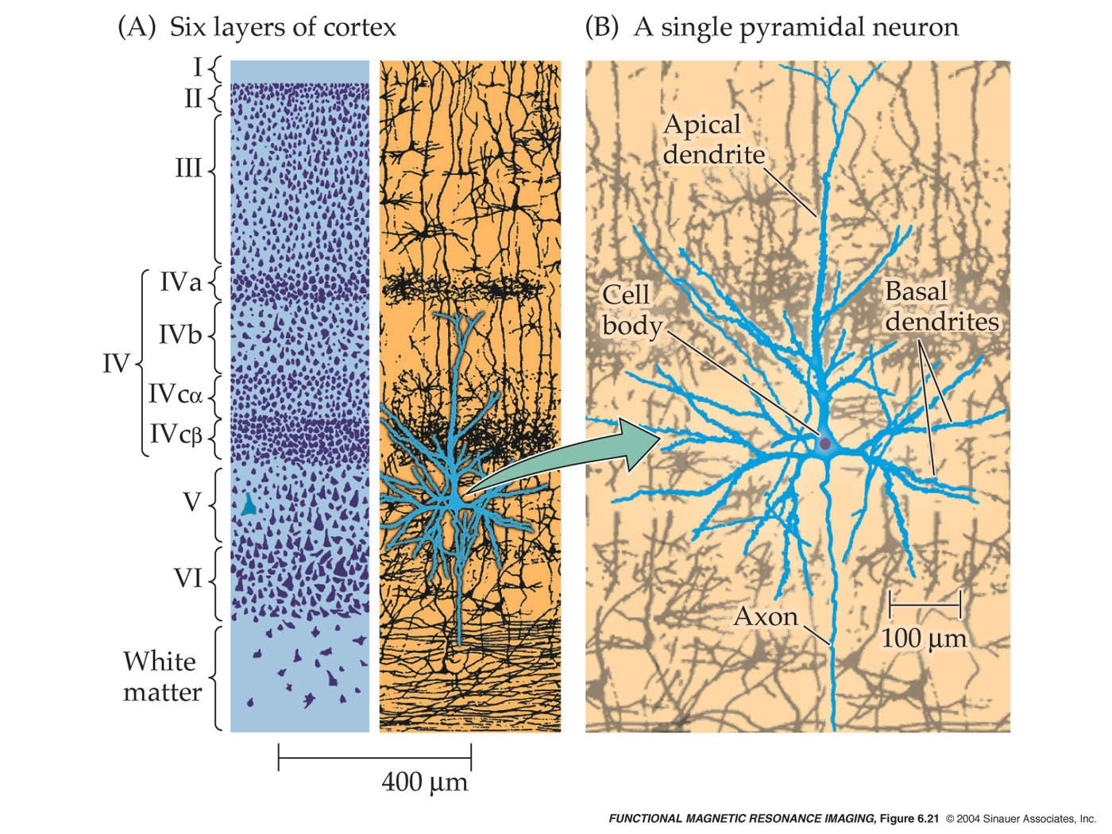
Neuron Anatomy
Neuron (Nerve Cell)
  basic functional unit of the nervous system
  Communication btwn neurons is chemical
Four Distinct parts of the Neuron
  Cell Body
  Axon
  Dendrites
  Synapses
52

Slide 53
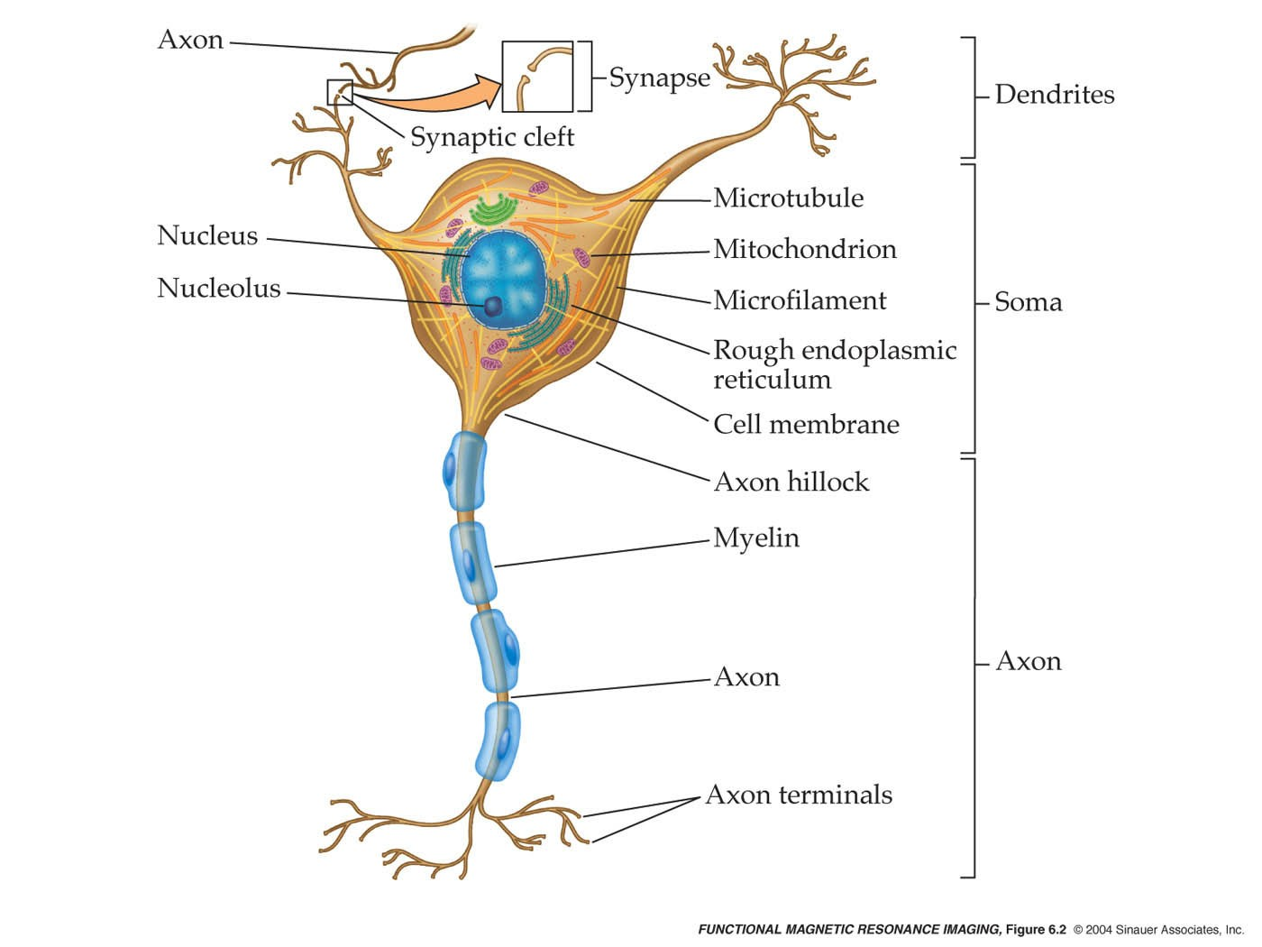
Neurons have specialized processes that support electrochemical transmission

Slide 54
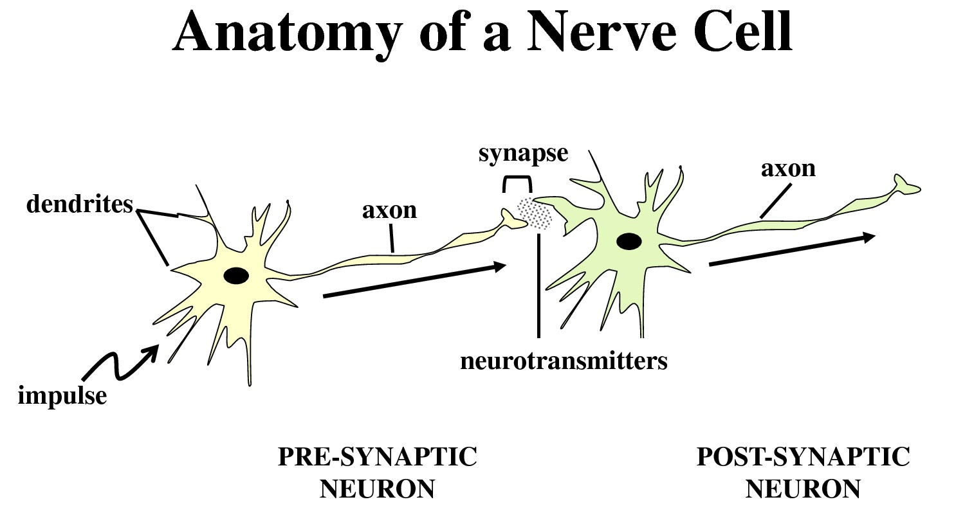
54

Slide 55
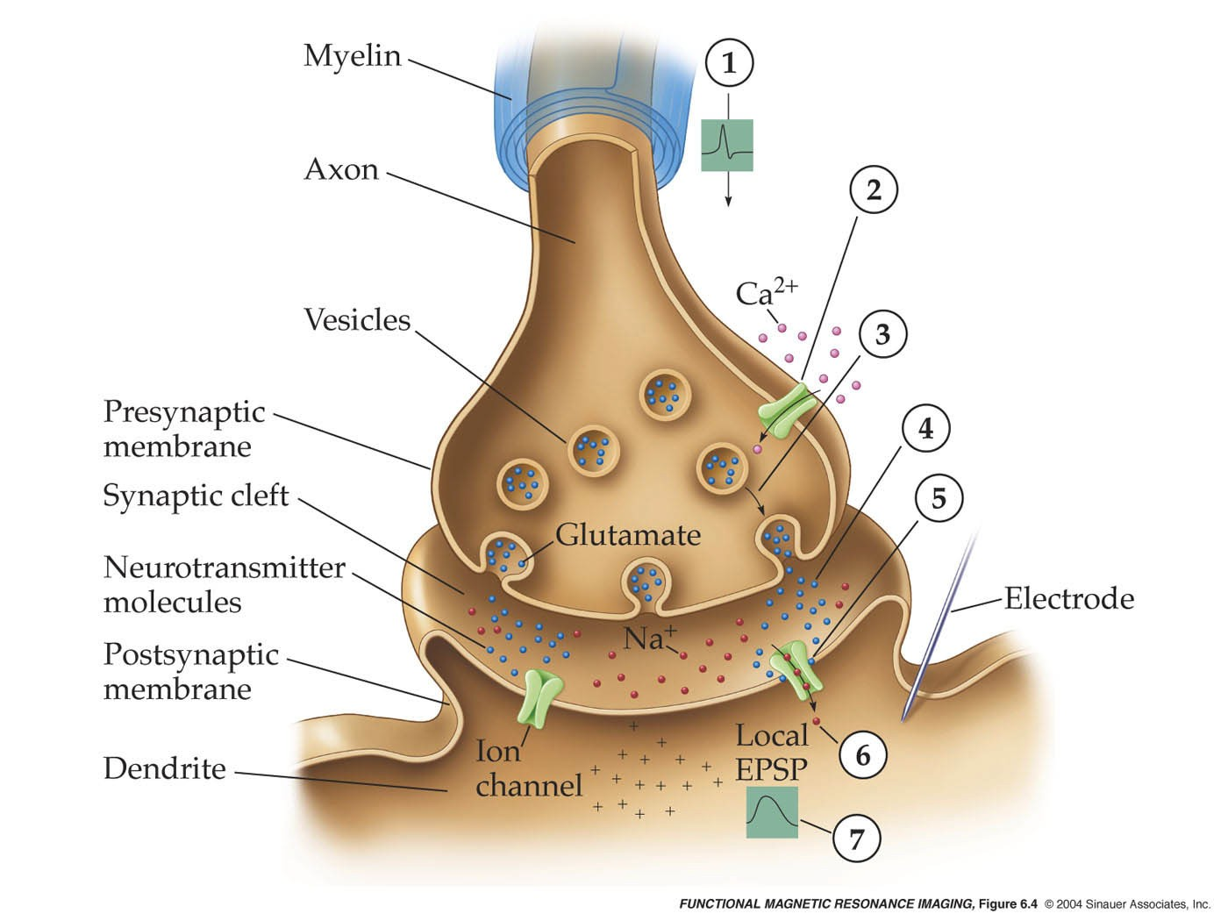
Neurons communicate with each other primarily through synapses

Slide 56
NT Regulation
Receptors are located in both the presynaptic & postsynaptic neurons
Presynaptic neurons serve as a “Negative Feedback Loop”
  Monitors levels of NT & up or down-regulates accordingly
Postsynaptic cells activate a biological response via:
  G-proteins, second messengers, direct actions
56

Slide 57
Neurotransmitters
Gamma-aminobutyric acid (GABA)
Glutamate
Norepinephrine (NE)
Dopamine (DA)
Serotonin (5HT)
Acetylcholine
57

Slide 58
Chemical Neurotransmission
Each step in the sequence of events is a potential target for pharmacotherapy
Currently psychotropic agent target:
  Neurotransmitters
  Receptors
  Enzymes
58

Slide 59
Neurotransmitters
Monoamines (biogenic amines) | Amino Acids | Cholinergics | Neuro-Peptides
Dopamine | Glutamate | Acetylcholine | Substance P
Norepinephrine | GABA |  | Somatostatin
Epinephrine | Glycine |  | Endorphins
Serotonin | Aspartate |  | Enkephalins
 |  |  | Dynorphins

Slide 60
Neurotransmitters
Chemicals that communicate information between neurons
Released from presynaptic terminals by nerve impulses
Can inhibit or excite receiving (post-synaptic) neuronal receptors
Activate genes-Pharmacogenomics
60

Slide 61
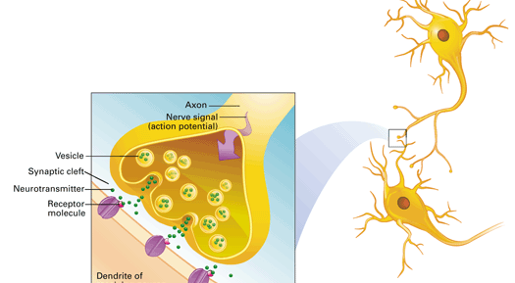
Neurotransmission
61

Slide 62
Receptors
Can be activated by medications or by endogenous chemicals called:
NEUROTRANSMITTERS (NT)
Receptors are named based on the associated NT
These activate the receptor and the Second Messenger System goes to work to activate biological responses
62

Slide 63
Enzymes
Enzyme inhibition has not been a target for many psychotropics
Inhibitors may be reversible or irreversible in nature
Primary example = Antidepressants- Monamine Oxidase Inhibitors
“Enzymes make things, receptors make things happen” via gene activation
63

Slide 64
Neurotransmitter Dysregulation as Pathophysiology
Medications to treat psychiatric illness came first
Theories of pathophysiology were developed based on mechanism of action
Dopamine hypothesis of Schizophrenia
“Monoamine Hypothesis of Depression”
Monoamine Receptor Hypothesis of Depression
64

Slide 65
NT-Actions
Agonist-mimics or increases the effect of a NT when bound to the receptor
Antagonist-blocks or decreases the effect of a NT by binding to the receptor
Partial Agonist- has the action of enhancing or increasing the effect of a NT, but not fully
Inverse Agonist -opposite effect of an agonist (ex. closes channel)
65

Slide 66
Receptors Systems
Self-regulating systems:
Up-regulation = increase in the number of neuronal receptors in response to low levels of NT
Down-regulation = decrease in the number of receptors in response to high levels of NT
Allosteric Modulation:
Indirect actions of multiple NT on receptors
66

Slide 67
Major NT Systems
Acetylcholine
Monoamines
  Catecholamines
    Dopamine
    Norepinephrine
    Epinephrine
  Indoleamines
    Serotonin
    Melatonin
Amino Acids
  GABA
  Glutamate
67

Slide 68
Receptor Subtypes
Acetylcholine (Nicotinic, Muscarinic)
Dopamine
– D1, D2, D3, D4, D5
Serotonin
– 5HT1A, 5HT1C, 5HT1D, 5HT2, 5HT3
NE
  alpha 1, alpha 2
  beta 1, beta 2
GABA
  omega 1, omega 2
Glutamate
  NMDA
68

Slide 69
Acetylcholine
Travels through the Basal Forebrain to hippocampus, amygdala, & cerebral cortex
Cholinergic receptors (nicotinic & muscarinic)
Widespread loss of cholinergic neurons with Alzheimer’s Disease
Anticholinergic response (dry mouth, blurred vision, constipation, urinary retention)
Mechanisms also include learning & memory
69

Slide 70
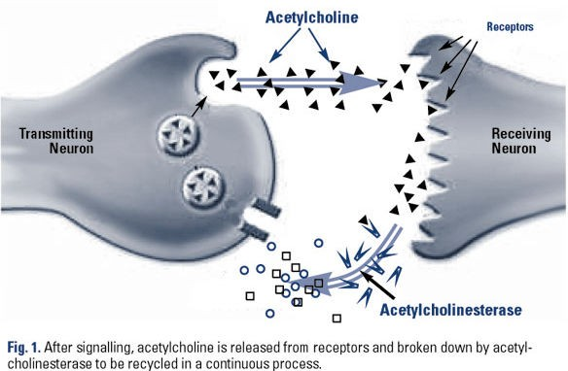
Acetylcholine
70

Slide 71
Dopamine (DA)
Located in cerebral cortex, limbic system
Dopamine Hypothesis of Schizophrenia
D2 over activity involved in psychosis
All antipsychotics block D2
Cognitive Function = Attention, working memory, concentration
Stimulants medications used for ADHD- enhance DA & NE via blocking reuptake or
direct agonism
Parkinson’s Disease -Insufficient DA-agonists used to treat
71

Slide 72
Dopamine Pathways
Mesolimbic Pathway -Positive symptoms of Schizophrenia when DA is overactive (hallucinations, delusions)
Nigrostriatal Pathway -Parkinsonism and other Extrapyramidal symptoms when DA is under active or depleted.
Mesocortial Pathway -Negative Symptoms of Schizophrenia; Cognitive problems
Tuberoinfundibular Pathway -Elevated prolactin when DA is blocked (galactorrhea,gynecomastia, amenorrhea, impotence)
72

Slide 73
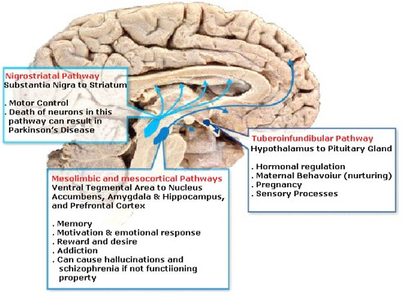
73

Slide 74
Norepinephrine (NE)
Located in locus ceruleus in pons, cerebral cortex, limbic system, hypothalamus, & thalamus
Receptors: Alpha1, Alpha 2; Beta 1; Beta 2
Implicated in the following:
  Mood, arousal, sexual functioning
  Cognition
  Attention/Concentration
  Working Memory
  Information Processing
  Anxiety & Mood Disorders
  Psychomotor Activity
74

Slide 75
Serotonin (5HT)
Located in raphe region of lower midbrain & upper pons; raphe nuclei, dorsal raphe, basal ganglia, & cerebral cortex
Implicated in the following:
  Affective Disorders
  Anxiety Disorders
  Impulsivity
  Aggression
  Obsessions & compulsions
  Food craving; bulimia
  Diurnal variation, sleep
75

Slide 76
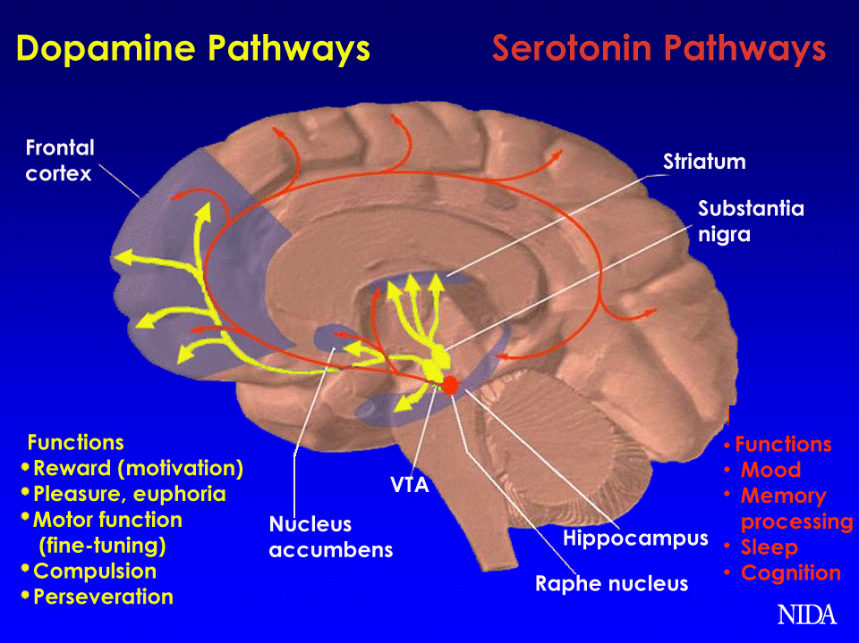
201312/12 76

Slide 77
GABA and Glutamate = Amino Acids
Glutamate
  Major Excitatory NT in the brain
GABA-gamma-aminobutyric acid
  Major Inhibitory NT in the brain
  GABA-A receptors are modulated by several nearby receptors
    Benzodiazepines
    Non-benzo sedative-hypnotics
    Alcohol
    Barbiturates
77

Slide 78
References
Sadock, B., & Sadock, V. (2007). Synopsis of psychiatry (10th ed.). London: England: Lippincott, Williams, and Wilkins.
Stahl, S. (2013). Essential psychopharmacology: Neuroscientific basis and practical applications (3rd ed.). Cambridge, England: Cambridge University Press.
78

