Slide 1
Economic Foundations
The Tragedy of the Commons

Slide 2
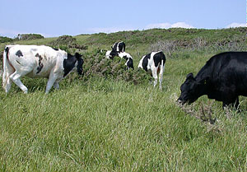
The Tragedy of the Commons

Slide 3
Example. Sam and Stan are identical twins with a craving for chocolate malted milkshakes, and have agreed to share one.

Slide 4
If each has a straw and each knows that the other is self-interested, will the rate at which they consume the milkshake be optimal?
Each knows that any part of the milkshake he doesn't drink will be drunk by the other.
So each consumes at a faster rate than he would if he had half the shake all to himself.

Slide 5
Examples of Tragedies of the Commons
Harvesting timber on public land.

Slide 6
Each tree cutter knows that a tree not harvested this year will be bigger, and hence more valuable, next year.
But he also knows that if he doesn't cut the tree down this year, someone else will.

Slide 7
Picking blackberries in a public park

Slide 8
Each individual knows that the blackberries would taste better if allowed to ripen for another week.
But each also knows that blackberries not eaten today may not be there next week.

Slide 9
Harvesting whales in international waters

Slide 10
Each individual whaler knows that harvesting an extra whale reduces the breeding population of whales and hence the size of future whale populations.
But he also knows that any whale he fails to harvest today will just be taken by some other whaler.

Slide 11
Environmental pollution: each individual polluter has no incentive to take into account the cost his pollution imposes on others.

Slide 12
Externality
The uncompensated impact of one person’s actions on the well-being of a bystander.
Examples: automobile exhaust, historic buildings, barking dogs, R&D.

Slide 13
Social Optimum
Point at which the marginal benefit equals marginal cost.

Slide 14
Figure 1 The Market for Aluminum
Price of
Aluminum
Supply
(private cost)
Equilibrium
Demand
(private value)
0
Q_{MARKET}
Quantity of
Aluminum
Copyright © 2004 South-Western

Slide 15
Figure 2 Pollution and the Social Optimum
Price of
Social
Aluminum
cost
Cost of
pollution
Supply
(private cost)
Optimum
Equilibrium
Demand
(private value)
0
Q_{OPTIMUM}
Q_{MARKET}
Quantity of
Aluminum
Copyright © 2004 South-Western

Slide 16
Internalizing the Externality
Altering incentives so that people take account of the external effects of their actions.
Clearly defined property rights are one way to solve the tragedy of the commons

Slide 17
Weyerhauser doesn't cut trees down too quickly on its own land.

Slide 18
People don't harvest blackberries too soon from their backyard garden.

Slide 19
People don't dump toxic wastes into their own swimming pools.

Slide 20
Regulation also plays a role:
Fishing licenses limit the amount of fish that can be taken.

Slide 21
Laws regulate air and water pollutants.

Slide 22
Zoning laws limit the size and other features of buildings, signs, land-use patterns, etc.

Slide 23
Taxes lead people to account for how their actions affect others.
Beverage Container Deposit Laws

Slide 24
Several species of whales have been hunted to near extinction because international laws of property are insufficient to restrain individual incentives to kill whales.

Slide 25
The Mediterranean Sea has long had serious problems with pollution, because none of the many nations that border it has an economic incentive to consider the effects of its discharges on other countries.

Slide 26
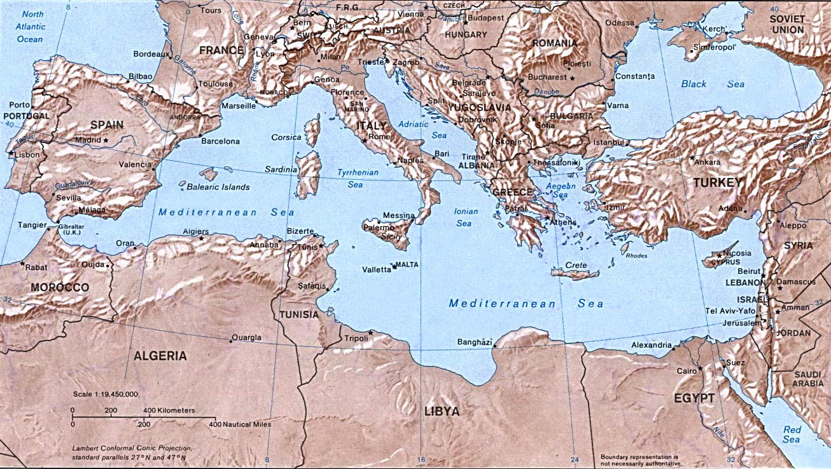

Slide 27
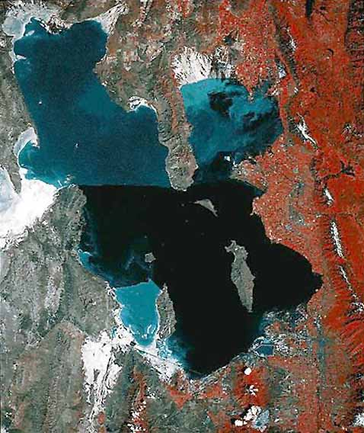
The Great Salt Lake: One jurisdiction, effective pollution control

Slide 28
Solutions
Bans
Limits
Rules and regulations
Taxes
Litigation

