Slide 1
Value-Based Purchasing
Chapter 9:

Slide 2
Chapter Outline
Context, Introduction, and Definition
Overview of Value-Based Care Financial Models
Evolution of Value-Based Purchasing by Funding Segment
Strategies and Capabilities to Succeed in Value
Key Learnings in the Evolution Toward Value-Based Care

Slide 3
Context, Introduction, and Definition
The US healthcare delivery system is largely designed to pay for volume (“fee-for-service”) and not the value of care.
US healthcare system – Despite significant investment from both taxpayers and the private sector and spending by far the greatest percentage of gross domestic product (GDP) for healthcare services – produces some of the worst outcomes among industrialized nations.
Unsustainable

Slide 4
Context, Introduction, and Definition
Slow movement toward creating population-based reimbursement and healthcare delivery models – called value-based models – that are intended to increase efficiency and reduce costs while improving quality and experience for the patient
The primary goal of value-based care is to reduce the total cost of care while improving clinical quality and patient experience.

Slide 5
Context, Introduction, and Definition
First Curve: Volume Based
Fee-for-service reimbursement
High quality not rewarded
No shared financial risk
Acute inpatient hospital focus
Information technology investment
incentives not seen in hospital
Stand-alone care systems can thrive
Regulatory actions impede hospital-physician collaboration
Second Curve: Value Based
Payment rewards population value: Quality and efficiency
Quality affects reimbursement
Partnership with shared risk
Increased patient severity
Information technology utilization essential for population health management
Scale increases in importance
Realigned incentives, encourage coordination

Slide 6
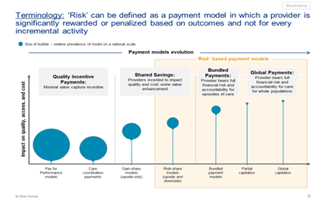
Overview of Value-Based Care Financial Models
Progression of Value-Based Care Risk-Reward Agreements

Slide 7
Overview of Value-Based Care Financial Models
Most VBP programs are driven by the payer and include the following foundational components: a defined population for which lower costs and improved quality is desired, financial rules for how savings and rewards will be shared between program constituents, desired outcomes for that population, and how program constituents will work together to drive these outcomes.
Attribution Model
Financial Model
Quality Standards
Collaboration Model and Additional Contractual Details

Slide 8
The Evolution of Value-Based Purchasing
A multitude of VBP models are currently in use in the United States, as a result of the fragmented US healthcare payer and provider landscape, variation in population needs across payer segments and geographies, and differing macroeconomic incentives across payer types:
Medicare
Private Payers
State-Based Medicaid
All-Payer initiatives

Slide 9
The Evolution of Value-Based Purchasing
Medicare
Single largest driver of value-based purchasing innovation at scale
Accountable care organizations (ACOs) have arguably had the greatest impact on the healthcare industry.
Key design principles for value-based models:
Encourage as many providers to participate as possible, to cover as many beneficiaries as possible.
Equip and incent providers to assume downside risk.
Create savings for the Medicare Trust Fund.
Improve quality of care for Medicare beneficiaries.

Slide 10
The Evolution of Value-Based Purchasing
Private Payers
To capitalize on the investments ACOs had made in population health management, private payers began developing commercial ACO programs.
As of 2019, it was estimated that private-payer ACOs covered more than 30 million members nationally—triple the size of the original Medicare ACO beneficiary population.
Private-payer VBP programs vary widely in their constructs and cover commercial (under 65) populations as well as Medicare Advantage populations.

Slide 11
The Evolution of Value-Based Purchasing
State-Based Medicaid
States have had the opportunity to transform VBP models more dramatically than the federal government.
Many states have initiated radical VBP programs in Medicaid to rein in costs while improving coordination and quality of care.

Slide 12
The Evolution of Value-Based Purchasing
All-Payer Initiatives
The biggest limitation of payer-by-payer VBP models is that a given provider (a doctor or a hospital) typically cares for patients from a multitude of public and private payers.
Some states have taken radical steps to create all-payer initiatives to bring down cost and improve quality across the entire population.
Maryland
Oregon

Slide 13
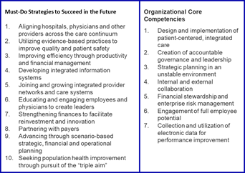
Strategies and Capabilities to Succeed in Value
Must-Do Strategies and Organizational Core Competencies for Value-Based Care

Slide 14
Key Learnings in the Evolution Toward Value-Based Care
Value-Based Arrangements Can Drive Sustained Improvements in Affordability and Quality, but the Extent of Improvement Is Inconsistent Across Segments.
Physician-Led Value Arrangements Drive Higher Savings Than Hospital-Led Equivalents.
Supporting Health Needs and Optimal Outcomes Requires Addressing Social Determinants of Health.
Structural Barriers to Value Persist—but the COVID-19 Pandemic Has Been an Accelerant.

