Slide 1
Population Health
Chapter 7:

Slide 2
Chapter Outline
Population Health Defined
Factors Influencing the Health of a Population
The Health of Our Communities
Improving the Health of Our Communities
Defining the Population of Focus
A Framework for Healthcare Organizations to Drive a Population Health Focus

Slide 3
Population Health Defined
The health outcomes of a group of individuals, including the distribution of such outcomes within the group.
A population health approach focuses on a defined population.
Population health represents a shift from a focus on improving the health of an individual patient to one of improving the health of a community.
It considers not just the aggregate of individual health statuses, but also characteristics of the community such as the healthiness of the housing, food, and physical environments.

Slide 4
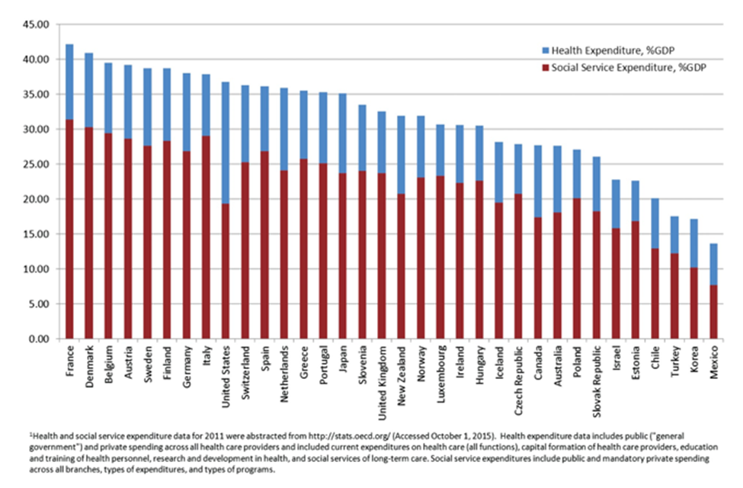
Factors Influencing the Health of a Population
Total expenditures as a percentage of GDP. Ratio of social services spending to healthcare spending.
Although the U.S. spends trillions on healthcare every year, we do not invest as much in things such as adequate access to housing, proper nutrition, and transportation
Source: From QJM, Volume 110(2), February 2017, p. 63.

Slide 5
Factors Influencing the Health of a Population
These social factors, including where a person is born, grows, lives, works, and ages, as well as health behaviors such as smoking, diet, and exercise, have more of an impact on health outcomes than genetic code or access to healthcare. Collectively, we commonly refer to these factors as social determinants of health (SDOH).
Source: AHA.

Slide 6
The Health of Our Communities
County Health Rankings
The University of Wisconsin Population Health Institute, with funding by the Robert Wood Johnson Foundation, has developed a model that provides a profile of community health
https://www.countyhealthrankings.org/
More than 30 measures
Data sources include various publicly available databases

Slide 7
Improving the Health of Our Communities
There are evidence-based strategies that governments and communities can implement to improve the health factors that impact health outcomes.

Slide 8
Defining the Population of Focus
Healthcare organizations accept responsibility for:
Providing recommended preventive care and health screenings to their defined patient population, such as immunizations, colorectal cancer screening, and breast cancer screening
Care management for their patients with serious chronic diseases, such as diabetes or heart disease
Focused interventions and programs for high-risk groups, such as those with high utilization of the emergency department or those with high readmission rates
Population focus may be further defined by shared savings models.

Slide 9
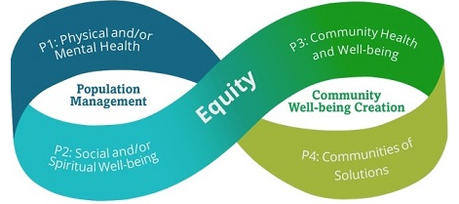
A Framework for Healthcare Organizations to Drive a Population Health Focus
Pathways to Population Health

Slide 10
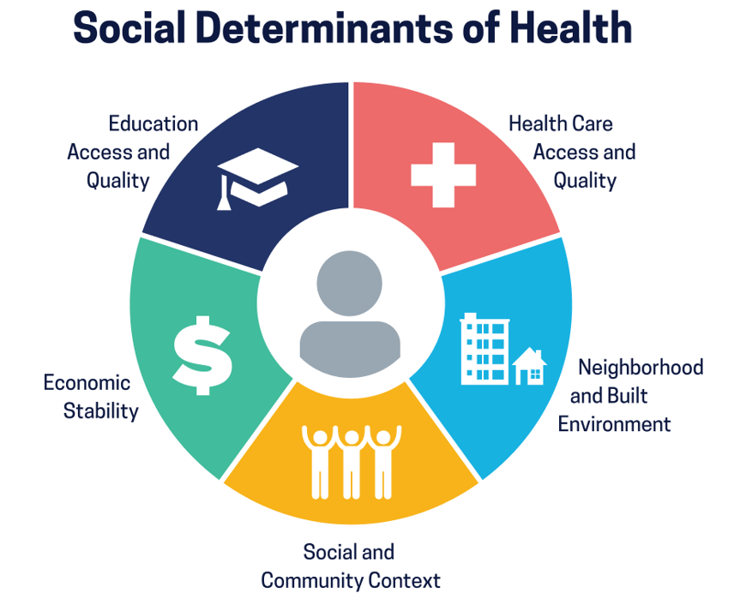
A Framework for Healthcare Organizations to Drive a Population Health Focus
SDOH
World Health Organization (WHO) defines SDOH as are the conditions in the environments where people are born, live, learn, work, play, worship, and age that affect a wide range of health functioning, and quality of life outcomes and risk.
Healthy People 2030 groups SDOH into 5 domains.

Slide 11
A Framework for Healthcare Organizations to Drive a Population Health Focus
Measuring SDOH
The National Association of Community Health Centers and several other organizations use the Protocol for Responding to and Assessing Patients’ Assets, Risks, and Experiences (PRAPARE) tool.
The American Academy of Family Physicians (AAFP) has a SDOH screening tool available as part of its The EveryONE Project, an initiative to help family physicians confront health disparities and improve the health of their patient populations.
CMS formed an Accountable Health Communities project.

Slide 12
A Framework for Healthcare Organizations to Drive a Population Health Focus
Identified SDOH needs
Important to connect patients to resources to address their identified SDOH opportunities
Evaluate the effectiveness of those interventions
How?
Creating lists
Leveraging electronic health record
Partner with external resources:
Aunt Bertha

