Slide 1
Chapter 5: Safety Science and High Reliability Organizing

Slide 2
Chapter Outline
Safety and Reliability
History of the Modern Safety Movement
Reliability as an Emergent Property
Descriptive Theories of High Reliability Organizations
Why Should We Care?
Creating Safety and High Reliability in Practice
Important Topics in Safety and High Reliability
Sustaining Cultures of Safety and High Reliability

Slide 3
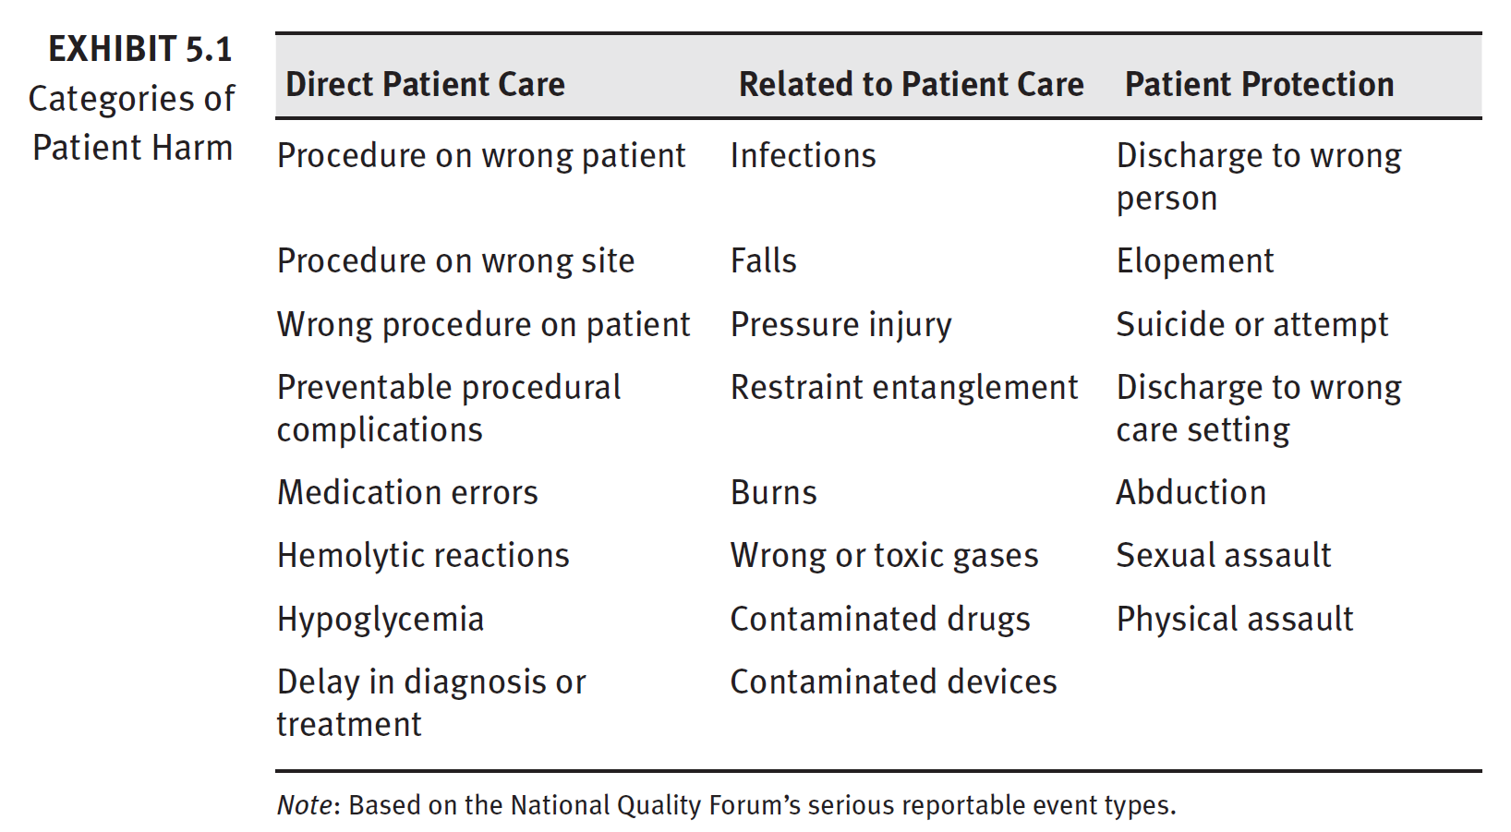
Categories of Patient Harm

Slide 4
Patient Harm
44,000 to 98,000 patient deaths per year from medical errors
To Err is Human, Institute of Medicine (1999)
210,000 to 440,000 patients per year suffer from preventable harm that contributes to their death.
James, John, “A New Evidence-based Estimate of Patient Harms…”
Journal of Patient Safety, September 2013, Volume 9, Issue 3
Medical error—the third leading cause of death in the U.S.
251,000 preventable deaths per year
Makary, M., and M. Daniel (2016), Johns Hopkins University School of Medicine

Slide 5
Reliability as an Emergent Property
Safety is not a part of a complex system; rather, it arises out of the interactions of parts of the system.
Reliability arises out of the numerous interactions of the parts.
Sharp End Model
The effects of people-only systems, automated systems, and hybrid systems can be summarized as follows:
People-only systems—low reliability and resilient
Automated systems—high reliability and brittle
Hybrid systems—high reliability and resilient
Resilience engineering—a body of knowledge within safety science and high reliability organizing—identifies sources of system resilience to be retained through thoughtful change management and detection and correction of drift in organizational performance.

Slide 6
Descriptive Theories of High Reliability Organizations
Across these descriptive theories, the significant overlap in the themes:
of leadership
thinking as a team
learning
The difficulty with a descriptive theory is that it merely tells what the organization should look like after the change has been made.
It does not reveal how to make the change in practice.

Slide 7
Why Should We Care?
Healthcare leaders should care about safety and high reliability for three main reasons:
Zero preventable harm is not achievable without safety science and high reliability organizing.
High reliability serves as a common framework for safety, quality, and patient experience.
Culture of “safety first” and high reliability ends the suboptimization effect that has plagued modern healthcare.

Slide 8
Creating Safety and High Reliability in Practice
Leader Tools
Start every meeting with a safety event
Human Performance Assessment (HPA)
Lead local learning systems

Slide 9
Creating Safety and High Reliability in Practice
Universal Skills
Attention on task
Communication
Thinking
Checklist and protocol use
Speak-up for safety

Slide 10
Weick and Sutcliffe (2007) created the best-known descriptive theory of HROs, detailed in their best-selling book Managing the Unexpected.
Preoccupation with failure. To avoid failure, look for early signs.
2. Reluctance to simplify interpretations. Use critical thinking and look past easy explanations to provide situational awareness.
3. Sensitivity to operations. Systems are dynamic and nonlinear, so leaders provide direct oversight to adjust to unpredicted interactions.
4. Commitment to resilience. The organization maintains function(s) during high demands. Resilience has three components:
– Absorb demands and preserve functions.
– Maintain the ability to return to service after untoward events.
– Learn and grow from untoward events.
5. Deference to expertise. Decision-making requires people with knowledge and experience, regardless of rank or status.

Slide 11
Important Topics in Safety and High Reliability
Just Culture creates an atmosphere of trust in which people are encouraged to provide, and even rewarded for providing, essential safety-related information but in which they are clear about where the line must be drawn between acceptable and unacceptable behavior.
James Reason
Managing the Risks of Organizational Accidents (1997)

Slide 12
Sustaining Cultures of Safety and High Reliability
Creating cultures of safety and high reliability is difficult, but sustaining those cultures can be even more challenging.
As the next generation of healthcare leaders, we could and should take two sustainment advantages not afforded to the innovators and early adopters:
Creating a standard professional culture
Immersion of reliability thinking beyond patient care spaces.

