Slide 1
Chapter 15: The Role of the National Committee for Quality Assurance Chapter Outline
Healthcare Quality: A Novel Concept
National Committee for Quality Assurance
Defining and Measuring Quality
Health Plan Accreditation
The Patient-Centered Medical Home
Key Issues in Quality Measurement

Slide 2
Healthcare Quality
1980s: No established, standardized way to evaluate health care or health plans
Healthcare spending rose from 7% of GDP in 1970 to >12% in 1990
NCQA established in 1990 as an independent, nonprofit organization to assess healthcare quality
Institute of Medicine (1990) defined quality as “the degree to which health services for individuals and populations increase the likelihood of desired outcomes and are consistent with current professional knowledge.”

Slide 3
HEDIS
1993: NCQA releases first public set of HEDIS (Healthcare Effectiveness Data and Information Set)
1995: First HEDIS Audit Committee convened to establish collection & reporting procedures
2017: Nearly all 40 states that use managed care plans to deliver Medicaid require those plans to report audited HEDIS data
HEDIS results are available to the public via NCQA’s Quality Compass database
HEDIS 2018 has 97 measures assessing effectiveness, access, experience, and utilization

Slide 4
Health Plan Accreditation
Overall accreditation status based on:
Clinical performance (HEDIS scores)
Member satisfaction (via survey)
Compliance with NCQA’s Standards & Guidelines for the Accreditation of Health Plans
Accreditation determined by product line: commercial, Marketplace, Medicare, and Medicaid
Results reported to public on the NCQA Health Plan Report Card

Slide 5
Patient-Centered Medical Home: Origin

Slide 6
Evolution of the NCQA PCMH Standards
2011
2014
2017
Emphasizes relationship with/expectations of specialists
Integrates behaviors affecting health, language, CLAS
Enhances evaluation of patient experience
Underscores importance of system cost-savings
Enhances use of clinical performance measure results
Further incorporates behavioral health
Additional emphasis on team-based care
Focuses on care management of high need populations
Higher bar, alignment of QI activities with “triple aim”
Addition of Annual reporting requirements
Further integrates social determinants & community connections
Further integrates behavioral health
Shift from focus on structure to focus on outcomes

Slide 7
NCQA Recognition Programs

Slide 8
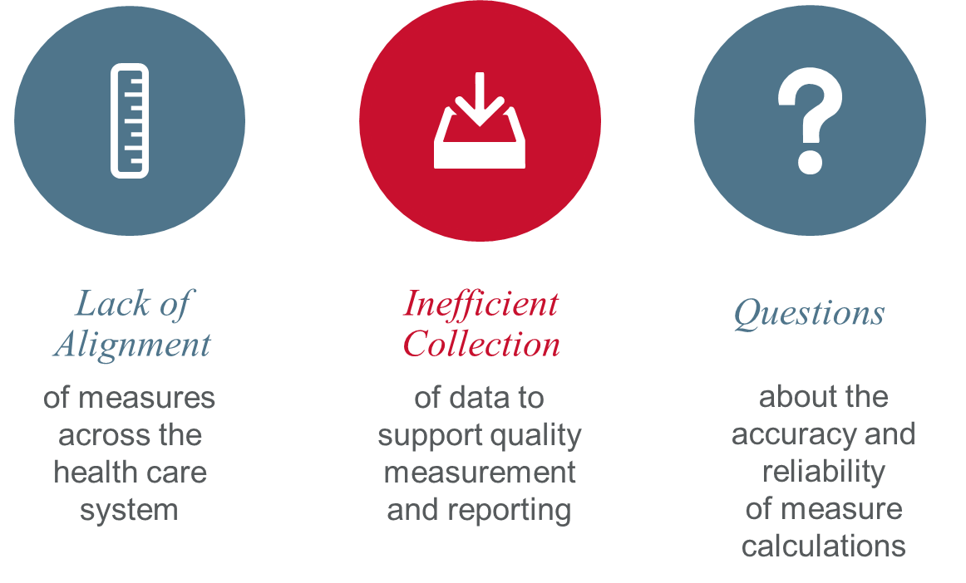
Key Issues in Quality Measurement

Slide 9
Study Questions
Why did employers and health plans agree to an external third-party evaluation program?
What role can or should accreditation and quality measurement/reporting play in the future, as the public availability of performance data increases and payment is linked to performance (or value)?
What policy drivers could states and the federal government use to drive quality up and cost down? Are the current efforts effective?
Does the current quality measurement approach lead to better quality and lower cost? Whether your answer is yes or no, how could the approach to measurement improve?
As CMS and states push to introduce value-based payment models, what mechanisms would you employ to assure the accuracy and validity of measurement data? Would you adjust reported performance rates and/or payment to account for population differences?

