Slide 1
Health System Transformation
Chapter 10:

Slide 2
Chapter Outline
A Foundation to Realizing Transformational Goals
An Unconventional Leadership Approach to Transformation
Reduce Cost While Improving Patient Quality
Transforming Quality and the Consumer Experience
Active Implementation Strategies
Making Change Stick: Workforce Culture and Behaviors

Slide 3
A Foundation to Realizing Transformational Goals
Begins with leadership from the board of trustees, the CEO, and the executive team
Baldrige Performance Excellence Framework
Kotter’s Eight-Step Change Process
  Unfreezing the old culture
  Forming a powerful guiding coalition
  Developing a vision and strategy
  Communication a vision and strategy
  Empowering employees to act on the vision and strategy
  Generating short-term wins
  Consolidating gains and producing more change
  Refreezing new approaches in the culture

Slide 4
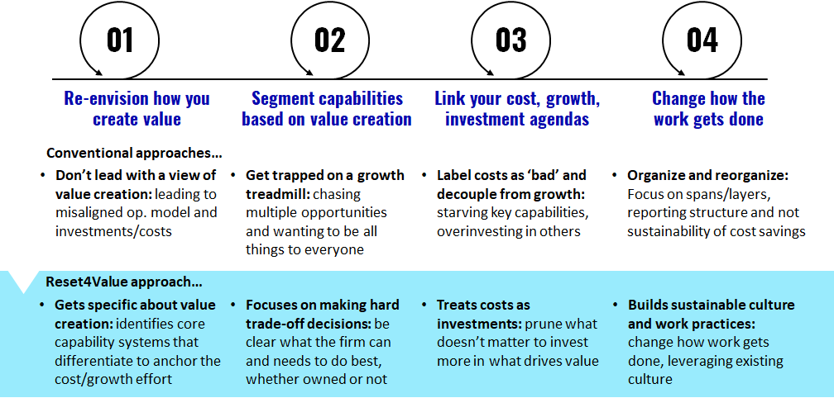
An Unconventional Leadership Approach to Transformation: Transformation Roadmap
Four acts of unconventional leadership often put the right mindset for transformation into practice.

Slide 5
An Unconventional Leadership Approach to Transformation: Develop a Fast, Factual View of the Root Issues
Transformations rely on facts and objectivity.
Working outside in – understanding market needs, evolutions, and trends, and then connecting this to an accurate view of organizational performance, strengths, and weaknesses is essential to producing an effective, grounded, and realistic transformation plan.
Access to robust and timely data is equally important as the transformational plan.

Slide 6
An Unconventional Leadership Approach to Transformation: Design a Structural Blueprint for Reallocation
Engaging a breadth of leaders, and allowing time for this process is important.
Engaging leaders also helps to ensure that the plan is practical to execute and reflects the realities of the organization’s starting point.
Finally, through a deliberate process, organizations can bring together diverse parts of the business, creating alignment around the vision, imperatives, and path forward.

Slide 7
An Unconventional Leadership Approach to Transformation: Pick Opportunities for Quick Wins and Self-Funding
Quick wins – changes that can be instituted quickly, with immediate results – help to demonstrate the possibility and progress of change.
Convert those who are less engaged into the transformative path.
Truly transformative efforts yield sustainable gains across all aspects of the value equation that require changes to the core operating model.

Slide 8
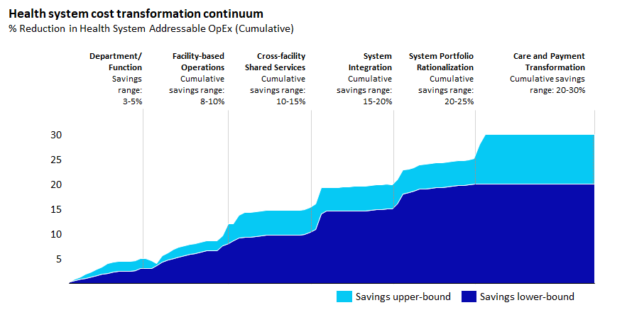
Reduce Cost While Improving Patient Quality

Slide 9
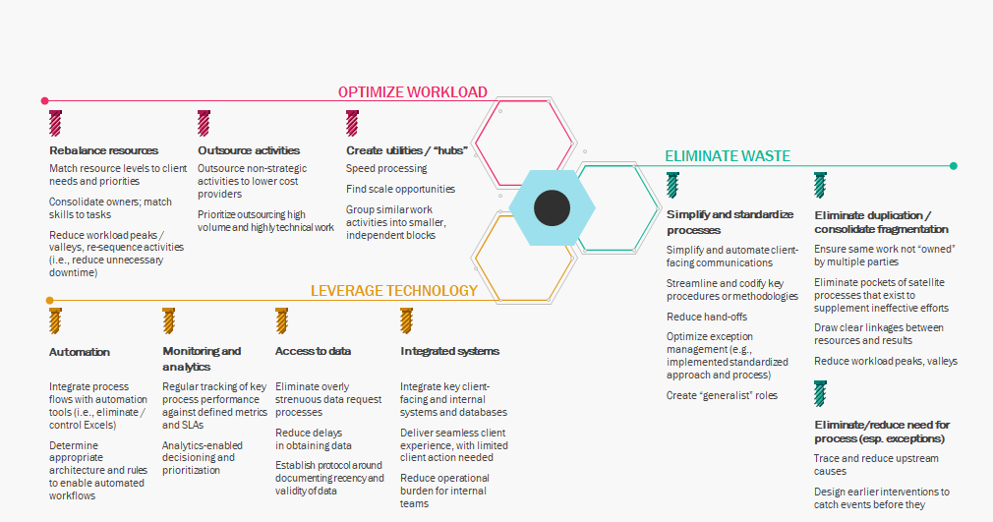
Reduce Cost While Improving Patient Quality
Top levers for process reengineering

Slide 10
Reduce Cost While Improving Patient Quality:
Reengineer the Process
Typical process reengineering challenges

Slide 11
Transforming Quality and the Consumer Experience
Patients are inherently diverse, with different needs, resources, educational levels, and health goals.
Physicians and other providers are trained to tell patients what they need – not what they want to hear.
Understanding core needs that extend beyond focusing on clinical issues is where leading organizations often find opportunities to render the quality care that patients need AND do it in a manner that engages, supports, and facilitates the person.
Culturally, the organizations that have truly transformed the consumer experience maintain a relentless focus on the people they serve.

Slide 12
Active Implementation Strategies
Strategies using live activities, especially those that involve multiple instructional techniques, have demonstrated more positive results.
Opinion leaders
Academic detailing
Reminder involved intervention
Audit and feedback systems
Administrative intervention
Multifaced interventions

Slide 13
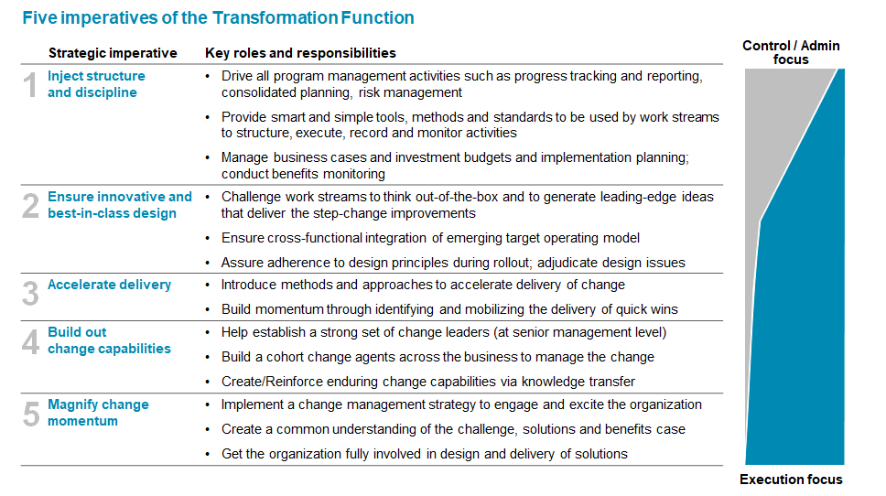
Making Change Stick: Workforce Culture and Behaviors

